Slide 1



High Consequence Infectious Disease (HCID) Preparedness Overview
March 6, 2026
PREPARE. PROTECT. RESPOND.

Slide 2



Sara Thul, MSN, RN RESPTC Outreach Specialist, University of Minnesota Medical Center

Slide 3

  Financial Relationships
The speaker has no relevant financial relationships or conflicts of interest to disclose.

Slide 4
Agenda
NSPS Overview
Special Pathogen Overview
Identify, Isolate & Inform
Region 5 Special Pathogen Notification and Transport Request
Education Offerings
NSPS in Activation

Slide 5
Learning Objectives
Identify differences between Level 1-4 Facilities as recognized by the NSPS
Define the Identify, Isolate, Inform Process
Describe Region 5 Special Pathogen notification and transport request process

Slide 6
NSPS Overview
PREPARE. PROTECT. RESPOND.

Slide 7
What is the NSPS?
The National Special Pathogen System (NSPS) is a tiered System of Care with four facility levels (e.g., Level 1, Level 2, Level 3, Level 4) that have increasing capabilities to care for suspected or confirmed patients with High Consequence Infectious Diseases (HCIDs).

Slide 8



Mission
To develop a coordinated network of high-quality special pathogen care dedicated to protecting patients, communities, and the health care workforce in the United States.
Vision
To save lives and protect the health care workforce through an agile and comprehensive special pathogen system of care.
ASPIRATIONAL GOALS
Zero
Preventable Deaths
after special pathogen infection
2 hours
Network Mobilization
after suspected special pathogen infection
100%
Have Access
to high-quality special pathogen care for all of the U.S. population

Slide 9


Ebola Outbreak
COVID-19 Pandemic
2014
2015
2018
2020
2021
2022
2023 +
NSPS was established and NETEC is rebranded to encompass all special pathogens
The Administration for Strategic Preparedness and Response (ASPR) tasked NETEC with developing the NSPS Strategy
3 new RESPTCs established
NETEC leads NSPS Strategy Implementation
NETEC and 10 Regional Emerging Special Pathogen Treatment Centers (RESPTCs) established
Special Pathogen Treatment Centers (SPTCs) and Assessment Centers established
Consolidated Appropriations Act designates NETEC as the coordinating body of the NSPS

Slide 10


Components of the NSPS
The NSPS is made up of a four-level tiered System of Care
The NSPS Coordinating Body is led by NETEC and provides services to NSPS facilities such as…
Level 1 – Regional emerging special pathogen treatment center and hub
Education & Training
Level 2 – Special pathogen treatment center
Consultation and Assessment
Level 3 – Assessment center
Special Pathogen Research Network (SPRN)
Level 4 – All healthcare facilities
International Partnerships & Programs
Additional partners, such as EMS and public health, are essential for the coordination of the System

Slide 11
NETEC’s Activities Areas
CONSULTATION & ASSESSMENT
EDUCATION & TRAINING
RESEARCH NETWORK
INTERNATIONAL PARTNERSHIPS
Empower hospitals to gauge their readiness using self-assessment
Provide direct feedback to hospitals via on-site assessment
Provide on-site and remote guidance
Provide emergency on-call mobilization
Deliver didactic and
hands-on simulation training via in-person courses
Provide self-paced education through online trainings
Compile an online repository of tools and resources
Develop customizable exercise templates based on the HSEEP model
Build a central IRB process for rapid implementation of clinical research protocols
Develop policies, procedures, and data capture tools to facilitate research
Create the infrastructure for a specimen biorepository
Organize, plan, and implement strategic international collaborations
Strengthen relationships with global special pathogens programs​
Establish mechanisms to facilitate sharing of best practices and knowledge among special pathogens programs
Cross cutting, supportive activities

Slide 12

Components of the NSPS
The NSPS is a hub-and-spoke model where ‘hubs’ (Level 1s) provide supporting centralized services to the ‘spokes’ within their domains (Level 2-4s)
NETEC
Is the NSPS Coordinating Body and provides resources to NSPS members
Level 1 RESPTCs
Provides regional coordination and outreach, resources, & highly specialized care
Level 2
SPTCs
Provides highly specialized care for the duration of illness
Levels 3 and 4
Provides short term safe care and/or coordinates rapid patient transfer to a Level 1 or 2
EMS and public health connects facilities throughout the NSPS.

Slide 13
Inspiration for a Tiered System of Care
The NSPS is inspired by other systems of care such as the trauma, stroke, and burn systems
The Trauma System has 3 different levels with increasing capabilities
The Stroke System has 4 different levels with increasing capabilities
The Burn System has a nationally coordinated network of specialized facilities
Tiered systems of care are common in healthcare
Faster
A tiered, national, coordinated System of Care that has increasing capabilities to safely and quickly care for suspected or confirmed patients with a special pathogen

Slide 14
Tiered System of Care
Level 1 facilities, or Regional Emerging Special Pathogen Treatment Centers (RESPTCs), are regional resources hubs which provide highly specialized care. Level 1s care for patients for their duration of illness.
Level 1
Level 2 facilities, or Special Pathogen Treatment Centers (SPTCs), have the capacity to deliver specialized care to clusters of patients and serve as primary patient care delivery centers. Level 2s can care for patients for their duration of illness.
Level 2
EMS
Public Health
Level 3 facilities, or Assessment Centers, are widely accessible care delivery facilities, able to conduct limited basic laboratory testing, stabilize patients, and coordinate rapid patient transfer. Level 3s can care for patients for 12-36 hours.
Level 3
Level 4 facilities, or All Other Healthcare Facilities, can identify, isolate, inform, & initiate stabilizing medical care; protect staff; and arrange timely patient transport to minimize impact to normal facility operations.
Level 4
Additional partners, such as EMS and public health, are essential for the coordination of the System

Slide 15
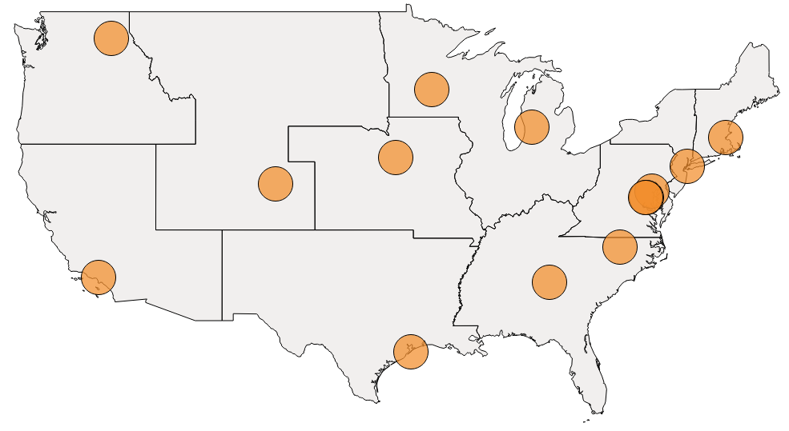
Level 1 Facilities
Regional Emerging Special Pathogen Treatment Centers
13 Facilities
Level 1 Role
Highly specialized care facilities
Resource hubs for their Region
Training & coordination leaders in their Region
Minimum Care Capabilities
Care for HCIDs for the duration of illness
Conducts training quarterly
Isolation space for 2+ VHF patients; 10+ patients with airborne illness
Provide care for adult, pediatric, OB, and neonatal patients
Funding & Status
All 13 RESPTCs maintain capabilities and are currently federally funded through ASPR.
Funded Annually
For more details on the specific capabilities, please see the NSPS minimum capabilities

Slide 16
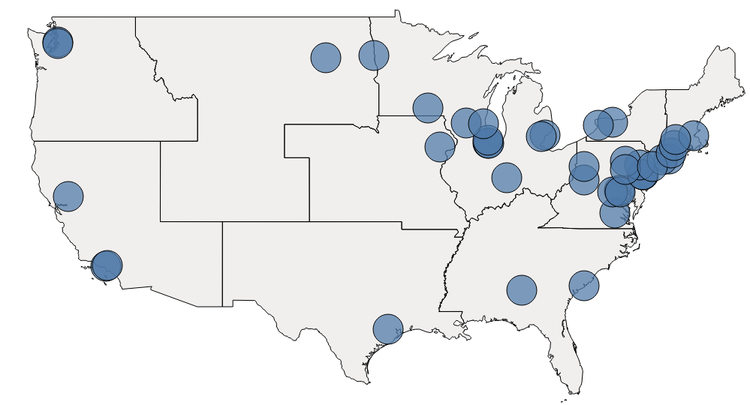
Level 2 Facilities
Special Pathogen Treatment Centers (SPTCs)
Goal of 75 Facilities
by 2026
Level 2 Role
Specialized care facilities
Primary patient care delivery centers
Essential for building the care capacity of the NSPS
Minimum Care Capabilities
Care for HCIDs for the duration of illness
Conducts training twice annual on donning/doffing; annually on skills
Isolation space for 1-2 VHF patients; 4+ patients with airborne illness
Provide care for either adult, pediatric, or both
Funding & Status
Recent funding opportunity for 75 Level 2 facilities
Mixed-Method Funding
For more details on the specific capabilities, please see the NSPS minimum capabilities
*Please note that facility mapping is ongoing and not all regions are fully visualized

Slide 17
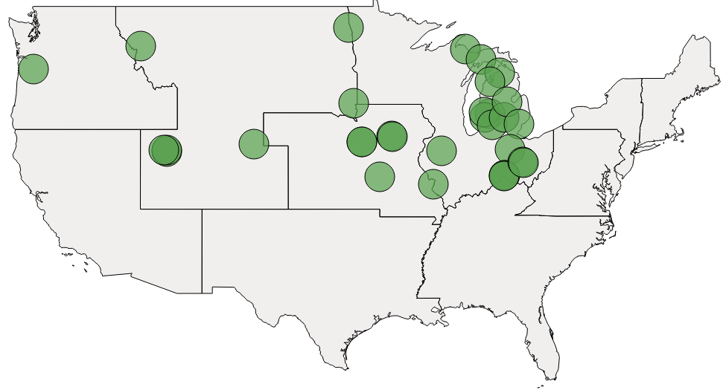
Level 3 Facilities
Assessment Centers
Goal of ~200 Facilities
Level 3 Role
Widely accessible care delivery centers
Conducts limited basic laboratory testing and clinical stabilization
Coordinates rapid patient transfer
Minimum Care Capabilities*
Care for HCIDs for 12-36 hours
Conducts training annual on donning/doffing; just-in-time training at time of activation
Has appropriate isolation space in ED or other accessible space (at least a single isolation space/neg pressure room)
Can safely identify, isolate, initiate stabilizing medical care
Funding & Status
Of the self-identified Assessment Centers who maintain capabilities, they may be funded in a variety of ways, though funding is generally limited.
Mixed-Method Funding
For more details on the specific capabilities, please see the NSPS minimum capabilities
*Please note that facility mapping is ongoing and not all regions are fully visualized

Slide 18
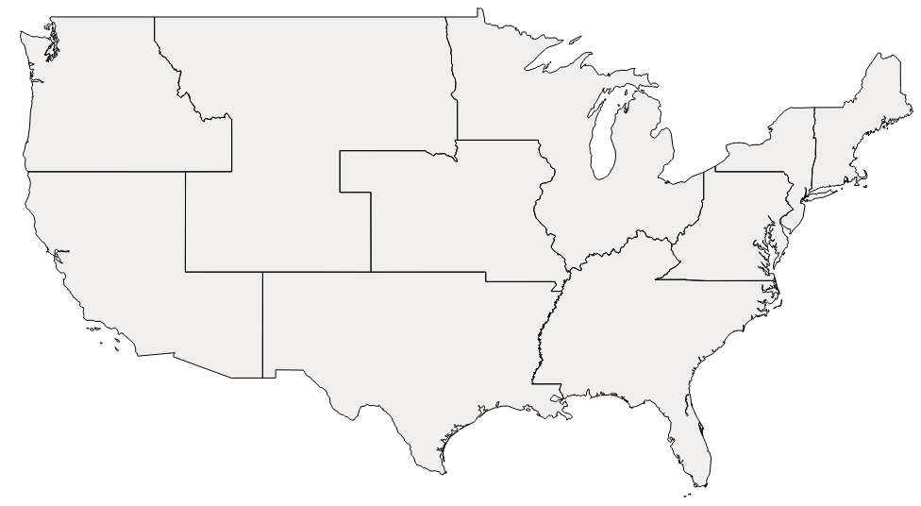
Level 4 Facilities
All healthcare facilities
All U.S. Facilities
Level 4 Role
Likely point of entry
Arranges timely patient transfer
Minimum Care Capabilities*
Can safely identify, isolate, inform, initiate stabilizing medical care
Protects facility staff
Arranges timely patient transfer
Funding & Status
Level 4 facilities encompass all other healthcare facilities across the U.S. and have the minimum new Joint Commission IPC required capabilities as appropriate.
Not Applicable
For more details on the specific capabilities, please see the NSPS minimum capabilities

Slide 19
High Level Capabilities Comparison
The table is intended to provide a high-level sample of quantifiable difference across levels and does not include all minimum capabilities.
Capabilities |  | Level 1 |  | Level 2 |  | Level 3
Care Duration |  | Duration of illness |  | Duration of illness |  | 12-36 Hours
Capacity for VHF, airborne |  | 2 VHFs 10 airborne |  | 1-2 VHFs 4 airborne |  | 1+ isolation space
PPE Supply |  | 2 VHF cases for at least 7 days onsite (with plans to support 21 days of care) |  | 1-2 VHF cases for at least 7 days onsite (with plans to support 21 days of care) |  | 3 VHF cases for 12-36 hours (before resupply)
Exercises |  | Quarterly |  | At least twice annually |  | At least once annually for mystery patient exercise
PPE Training |  | Quarterly |  | At least 2x annually |  | At least 1x annually
Skills Training |  | Quarterly |  | At least annually |  | --
Lab Testing Ability |  | Clinical lab testing |  | Clinical lab testing |  | Point-of-care onsite clinical lab testing

Slide 20
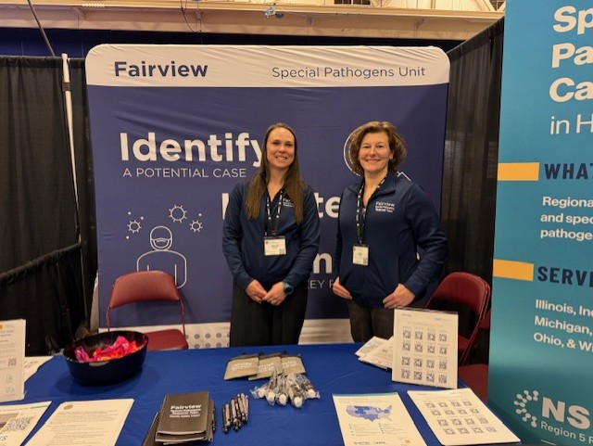

RESPTC
University of Minnesota RESPTC
NSPS Level 1 RESPTC since 2015
Ability to care for 2 adult or pediatric VHF patients
Ability to care for 10 airborne isolation patients
Provide outreach and education throughout
Region 5
On-Unit laboratory
Staff- volunteer based & extension of their
​floating cluster
Notes:
All facilities which are not specifically designated as a level 2 or 3 are by default level 4s and need to be able to identify, isolate, inform, and initiate stabilizing medical care; protect team members; and arrange timely patient transport.
If your hospital is accredited by The Joint Commission, please know that there were two new standards specific to special pathogens which were set in mid 2024.

Slide 21
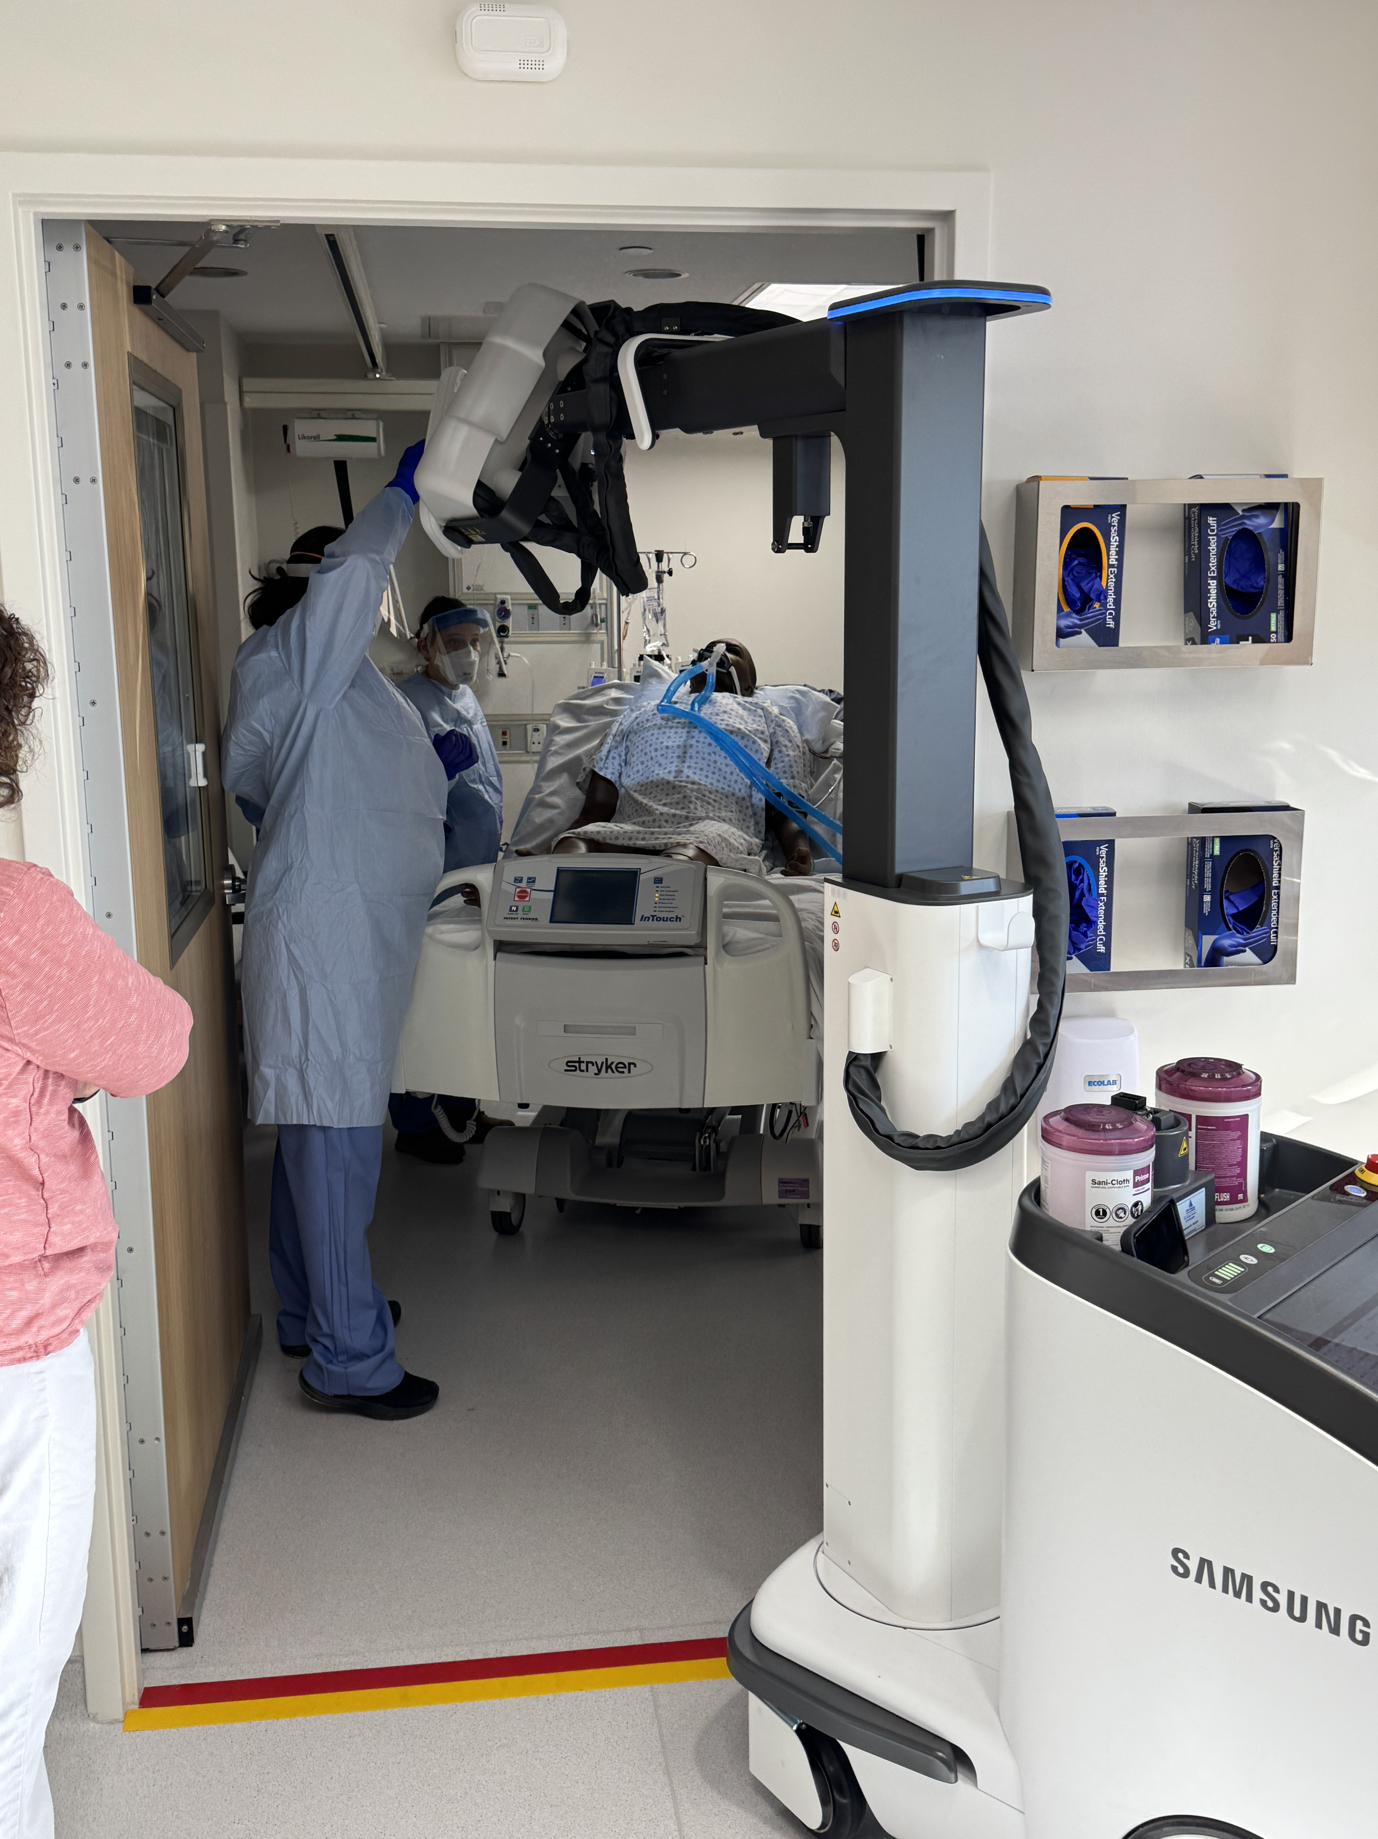
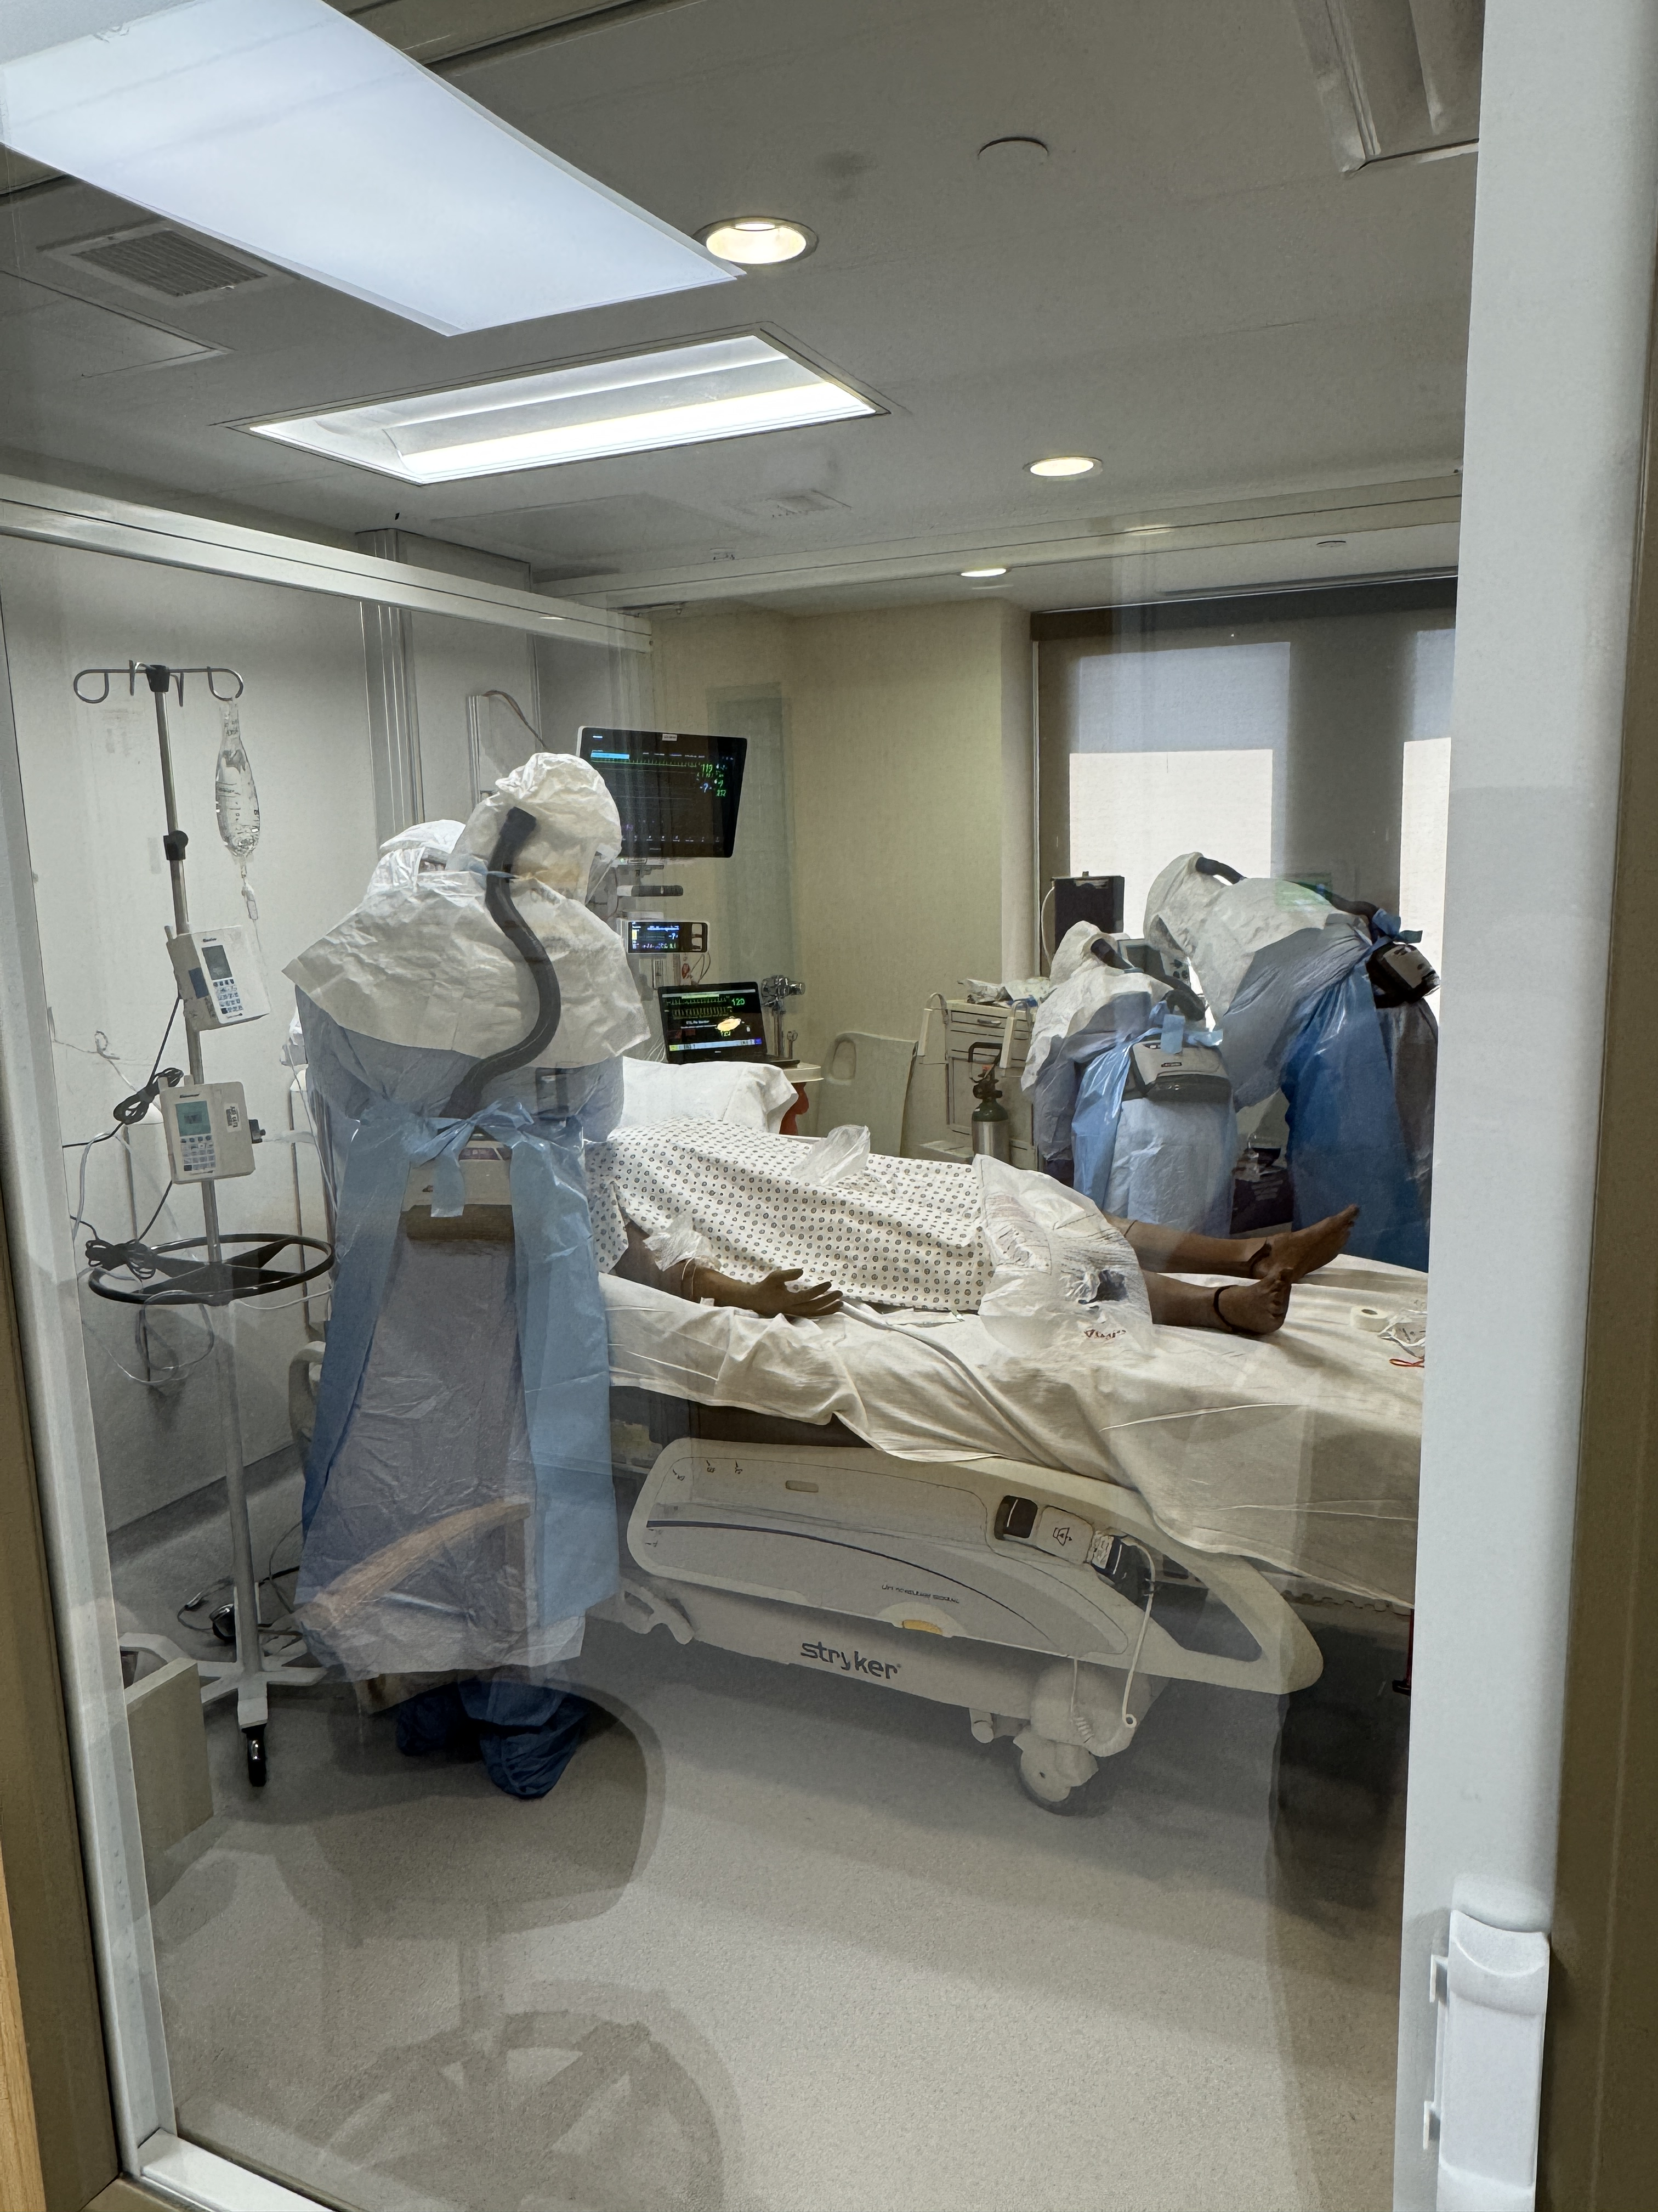
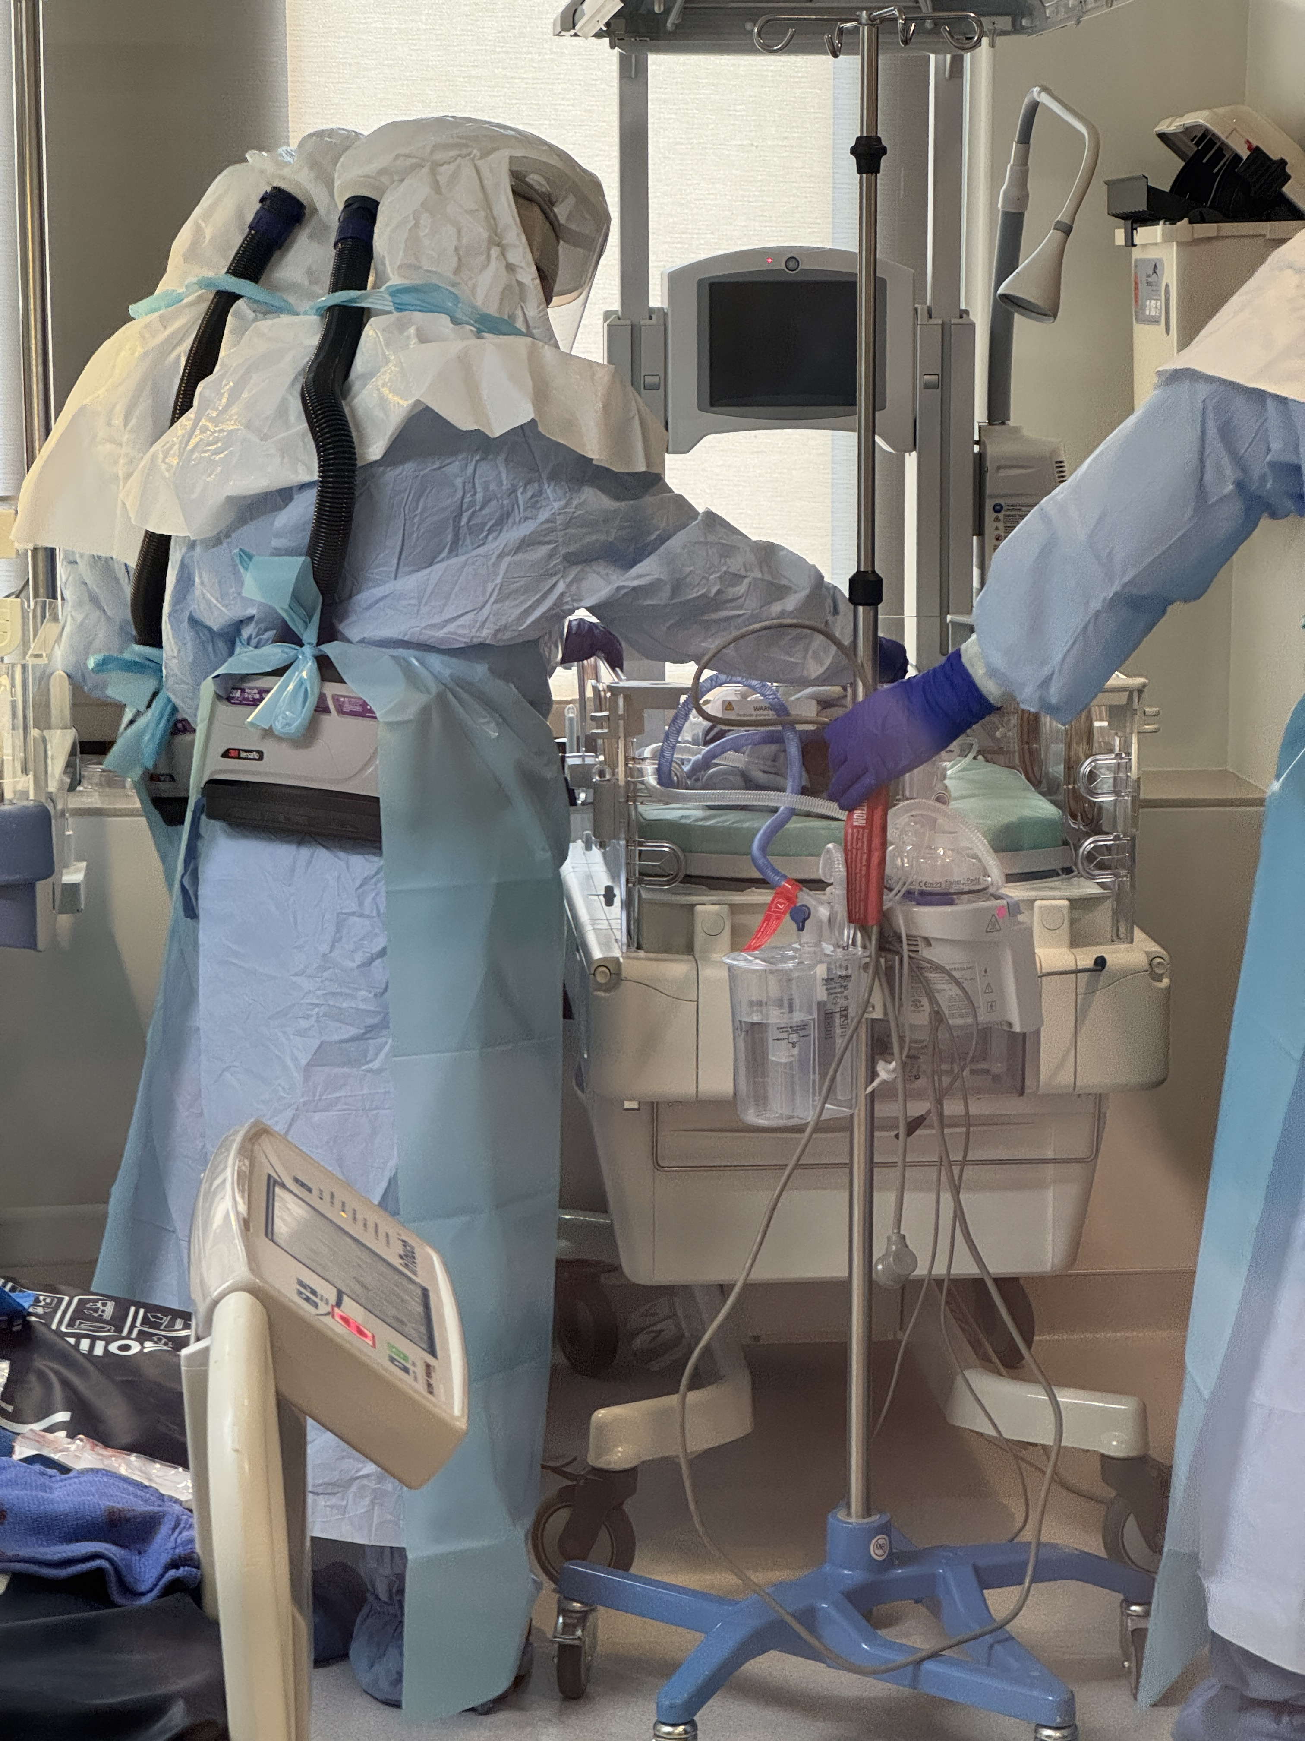
RESPTC
University of Minnesota RESPTC
Quarterly drills and exercises
Multi-disciplinary team
Photo credit: E.B. Floersh, University of Minnesota
Notes:
All facilities which are not specifically designated as a level 2 or 3 are by default level 4s and need to be able to identify, isolate, inform, and initiate stabilizing medical care; protect team members; and arrange timely patient transport.
If your hospital is accredited by The Joint Commission, please know that there were two new standards specific to special pathogens which were set in mid 2024.

Slide 22
Level 2 STAND AWARD
Role of NSPS Level 2 Facilities
Awarded facilities will:
Work toward achieving or maintaining NSPS Level 2 minimum capabilities with NETEC and RESPTC network support, assessment, and training
Deliver safe, specialized care for patients with HCIDs for the duration of their illness
Accept patients from within their HHS region, and if needed, from outside their jurisdiction or even outside the U.S.
Serve as an expert resource during surge
Partner with Level 1 facilities in their region
Join a Community of Practice with facilities nationwide
Funding at a Glance
Award amount: $500,000 per facility
Sites Awarded: 54 throughout US
Grant performance period: January 2, 2026 – June 29, 2026
Region 5 Awardees:
Nationwide Children's Hospital: Columbus, Ohio
Indiana University Health: Indianapolis, IN
Rush University Medical Center: Chicago, IL
Lurie Children's Hospital: Chicago, IL
University of Wisconsin Health Hospital: Madison, WI

Slide 23
Joint Commission Regulatory Requirements
The Joint Commission (TJC) added new requirements specific to infection control and prevention of high-consequence infectious diseases (HCID) or special pathogens which went into effect July 1st, 2024.
IC.07.01.01 has two elements of performance (EP).
  1 “The hospital develops and implements protocols for high-consequence infectious diseases or special pathogens. The protocols are readily available at the point of care and address: [Identify, Isolate, and Inform]”
  2 “The hospital develops and implements education and training and assesses competencies for the staff who will implement these protocols.”
Notes:
All facilities which are not specifically designated as a level 2 or 3 are by default level 4s and need to be able to identify, isolate, inform, and initiate stabilizing medical care; protect team members; and arrange timely patient transport.
If your hospital is accredited by The Joint Commission, please know that there were two new standards specific to special pathogens which were set in mid 2024.

Slide 24
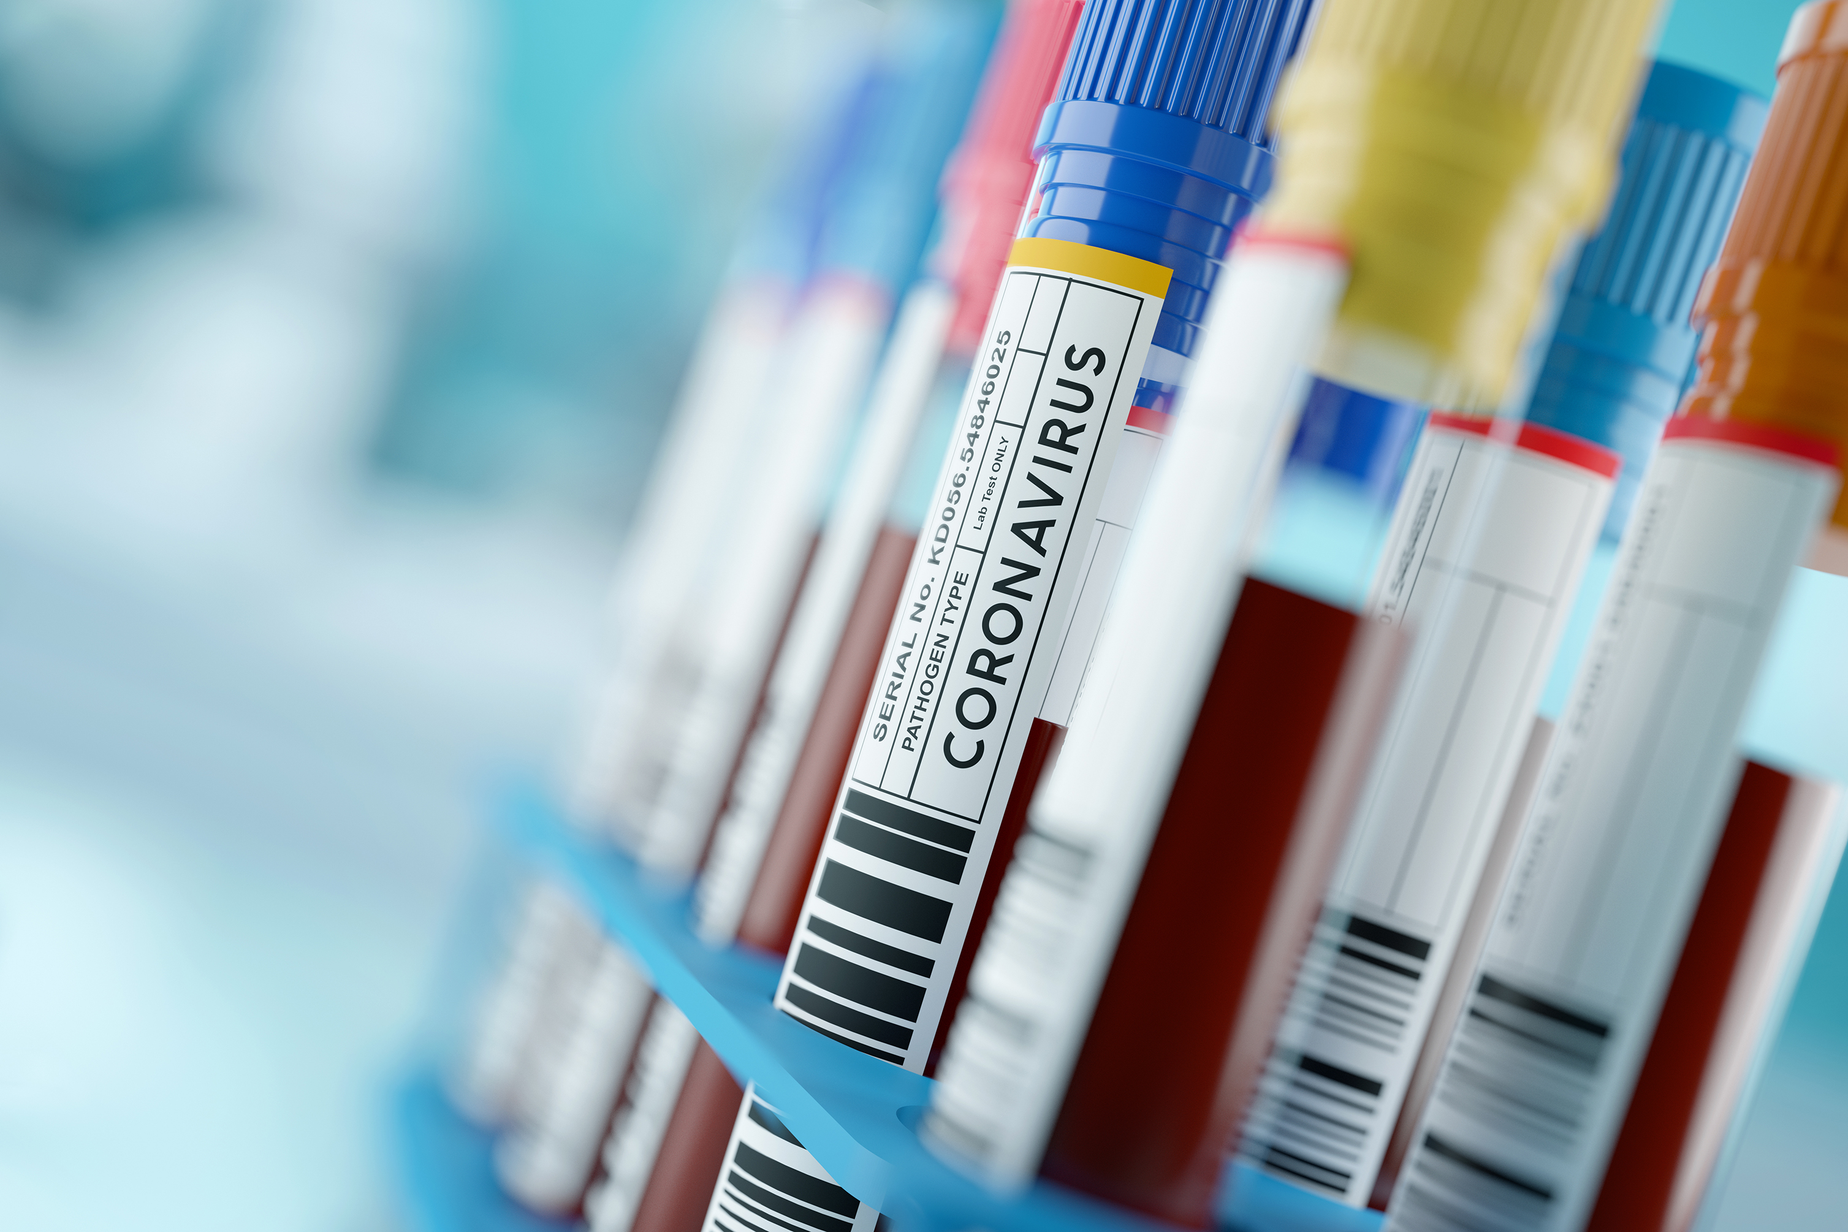
Level 4 Role –Lab
Contact your local state or public health department prior to collecting any specimens.
Center for Disease Control direction on Laboratory Testing for Patients with a Suspected VHF or High-Consequence Disease https://www.cdc.gov/viral-hemorrhagic-fevers/php/laboratories/index.html

Slide 25
Special Pathogen Overview
PREPARE. PROTECT. RESPOND.

Slide 26
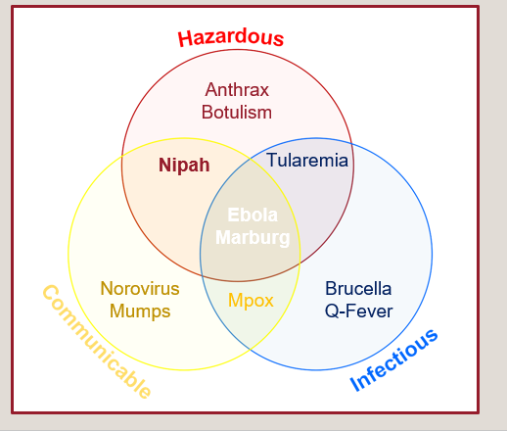
Reason for Concern
The diseases that encompass all three categories are Viral Hemorrhagic Fevers and are transmitted person to person.
Notes:
All facilities which are not specifically designated as a level 2 or 3 are by default level 4s and need to be able to identify, isolate, inform, and initiate stabilizing medical care; protect team members; and arrange timely patient transport.
If your hospital is accredited by The Joint Commission, please know that there were two new standards specific to special pathogens which were set in mid 2024.

Slide 27
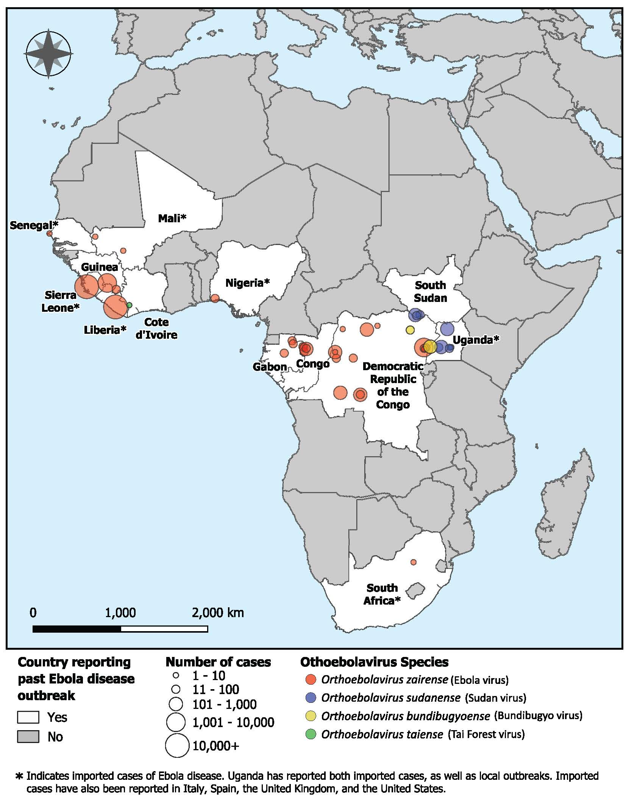
Ebola
What is Ebola?
A viral hemorrhagic fever caused by orthoebolavirus. It is transmitted by contact with body fluids or by bats & non-human primates.
There is a vaccine available: ERVEBO- managed by Strategic National Stockpile.
30-90%
Case fatality rate based on outbreak
Signs and Symptoms
Symptoms usually appear 2-21 (8-10 is average) days after a person is exposed. "Dry" symptoms include fever, weakness, headache, sore throat and can progress to "Wet" symptoms such as nausea/vomiting/diarrhea, unexplained bleeding.
Outbreak History | Ebola | CDC
Notes:
All facilities which are not specifically designated as a level 2 or 3 are by default level 4s and need to be able to identify, isolate, inform, and initiate stabilizing medical care; protect team members; and arrange timely patient transport.
If your hospital is accredited by The Joint Commission, please know that there were two new standards specific to special pathogens which were set in mid 2024.

Slide 28
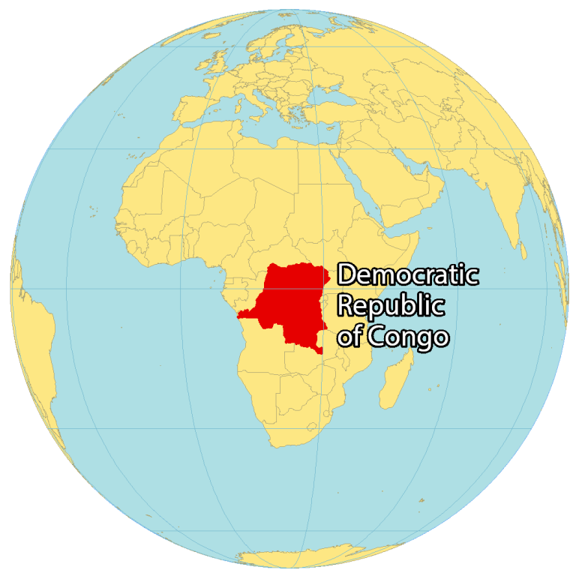
Ebola
Current Situation:
September 4, 2025: Democratic Republic of Congo declares outbreak in Kasai Province
November 5th, 2025: 64 people with confirmed or probable Ebola, including 45 deaths.
December 1st, 2025: WHO declares end to outbreak. 70% case fatality rate. Included 5 infected health care workers, 3 of whom died.
Recent Outbreaks:
January-April, 2025: Uganda (Sudan Ebola virus) 14 cases including 4 deaths
Ebola Outbreak in the DRC: Current Situation | Ebola | CDC
Democratic Republic of Congo Map - GIS Geography
Notes:
All facilities which are not specifically designated as a level 2 or 3 are by default level 4s and need to be able to identify, isolate, inform, and initiate stabilizing medical care; protect team members; and arrange timely patient transport.
If your hospital is accredited by The Joint Commission, please know that there were two new standards specific to special pathogens which were set in mid 2024.

Slide 29
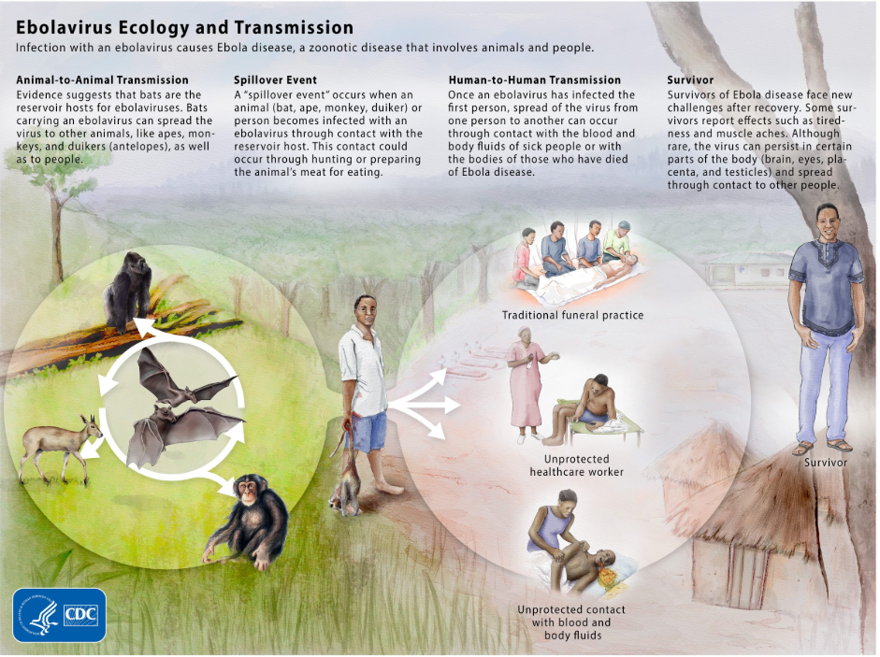

Slide 30
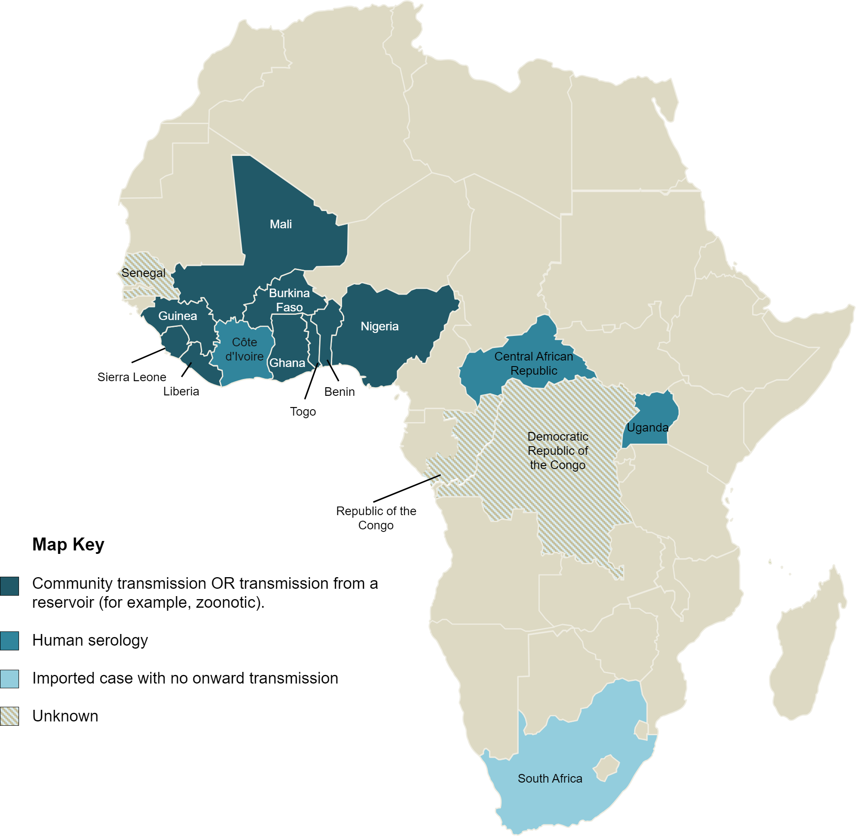
Lassa Fever
What is Lassa?
A viral hemorrhagic fever caused by an arenavirus. It is transmitted by ingestion, inhalation, or mucus membrane/broken skin contact with infective materials.
15-20%
Hospitalized Lassa cases globally have died.
Signs and Symptoms
Symptoms usually appear 7-10 days after a person is exposed. Common symptoms include fever, abdominal pain, nausea, diarrhea, sore throat.
Pharyngitis is recognized as a distinctive symptom that can distinguish LF from other endemic diseases. Severe cases may develop facial edema in the absence of peripheral edema.
UK Health Security Agency. Map of Lassa fever in Africa https://www.gov.uk/guidance/lassa-fever-origins-reservoirs-transmission-and-guidelines
Notes:
All facilities which are not specifically designated as a level 2 or 3 are by default level 4s and need to be able to identify, isolate, inform, and initiate stabilizing medical care; protect team members; and arrange timely patient transport.
If your hospital is accredited by The Joint Commission, please know that there were two new standards specific to special pathogens which were set in mid 2024.

Slide 31
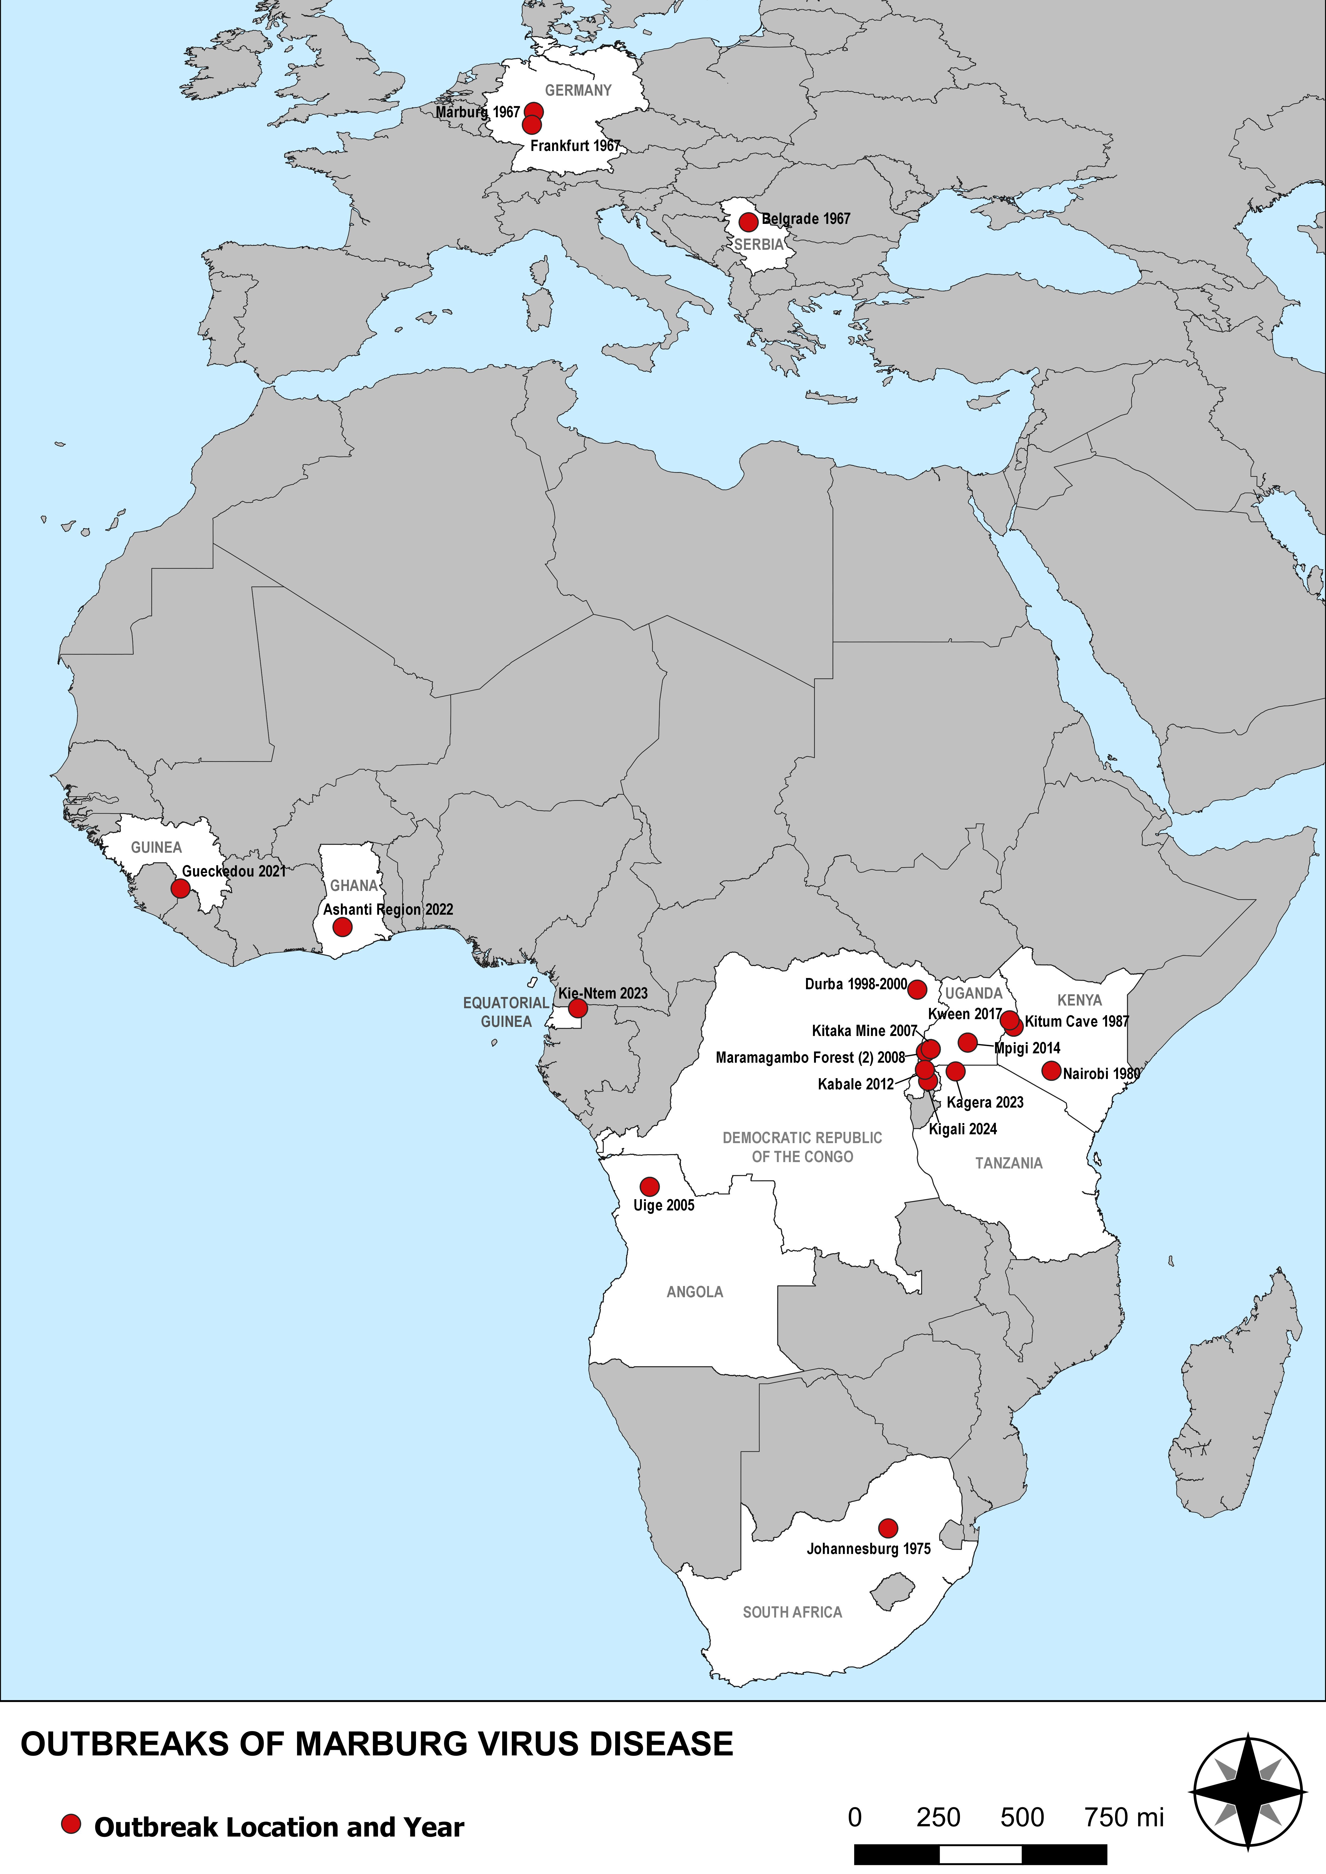
Marburg Virus
What is Marburg?
A viral hemorrhagic fever caused by orthomarburgvirus and is spread by bats or non-human primates to people.
20-90%
Case fatality rate (varied by outbreak)
Signs and Symptoms
Symptoms usually appear 2-21 days after a person is exposed. Common symptoms include fever, headache, muscle aches, rash often on torso, chest pain, sore throat, nausea, vomiting and diarrhea.
Advanced symptoms include liver failure, delirium, shock, hemorrhaging, and multi-organ dysfunction.
About Marburg | Marburg | CDC
Notes:
All facilities which are not specifically designated as a level 2 or 3 are by default level 4s and need to be able to identify, isolate, inform, and initiate stabilizing medical care; protect team members; and arrange timely patient transport.
If your hospital is accredited by The Joint Commission, please know that there were two new standards specific to special pathogens which were set in mid 2024.

Slide 32
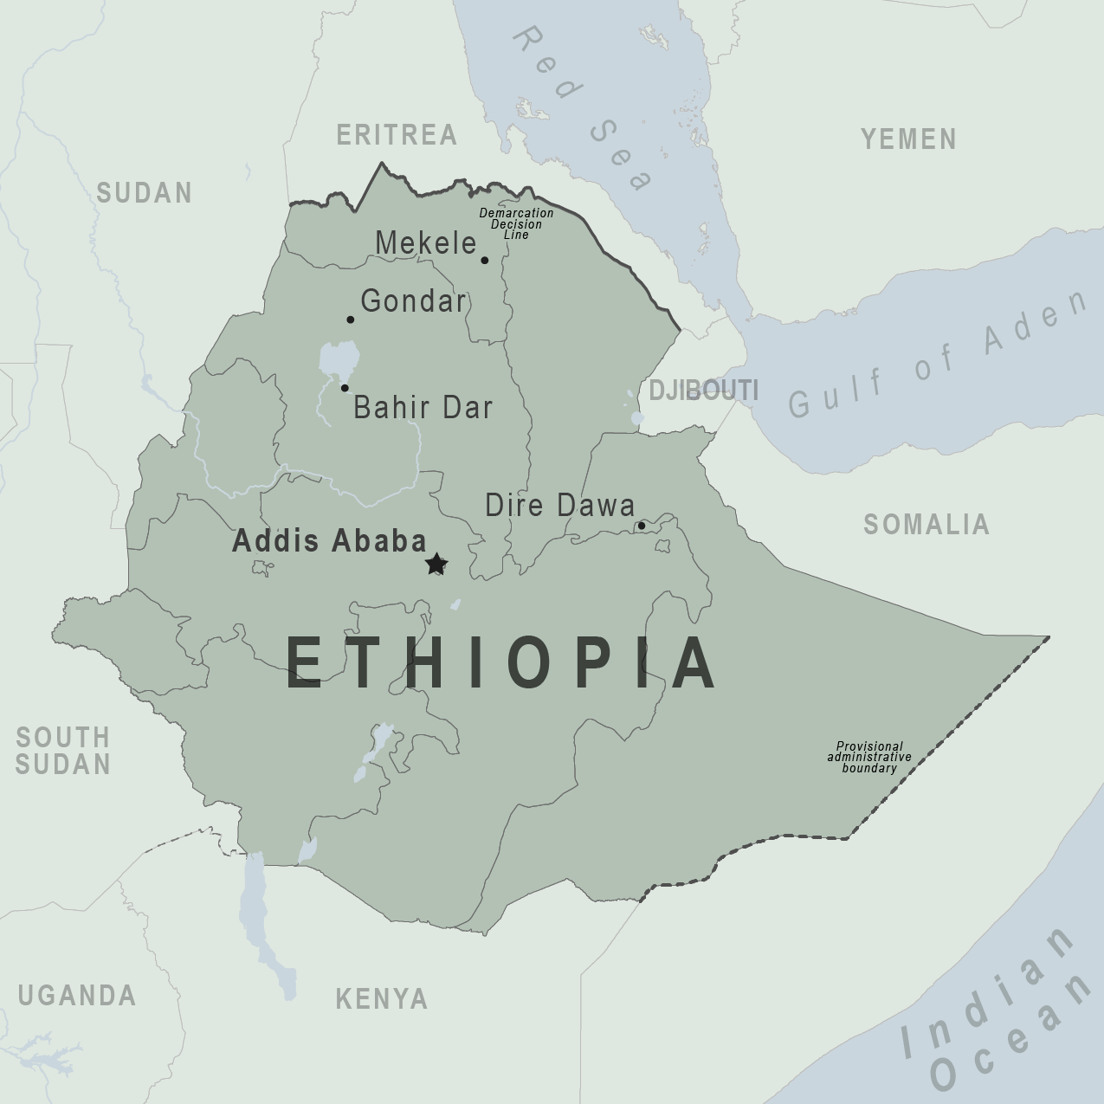
Marburg Virus
Current Situation:
November 14, 2025 Ethiopia Ministry of health reported first
Marburg outbreak
As of January 26, 2026: 14 lab confirmed cases & 9 deaths- Declared END of Outbreak
Recent Outbreaks:
Tanzania January-March, 2025: 10 confirmed & probable cases all resulted in deaths
Rwanda Sept-Dec, 2024: 66 cases, 15 deaths
Ethiopia - Traveler view | Travelers' Health | CDC
Notes:
All facilities which are not specifically designated as a level 2 or 3 are by default level 4s and need to be able to identify, isolate, inform, and initiate stabilizing medical care; protect team members; and arrange timely patient transport.
If your hospital is accredited by The Joint Commission, please know that there were two new standards specific to special pathogens which were set in mid 2024.

Slide 33
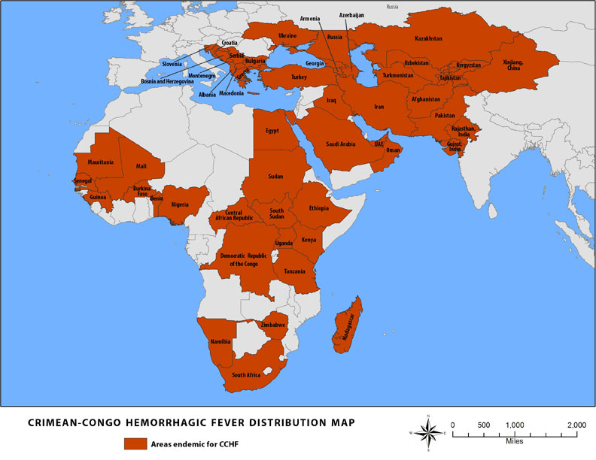
Crimean-Congo Hemorrhagic Fever
What is Crimean-Congo hemorrhagic fever?
A viral hemorrhagic fever caused by Nairovirus and is spread by ticks to people and livestock. A majority of cases occur in livestock, agricultural, slaughterhouse and veterinary workers.
10-40%
Case fatality rate (varied by outbreak)
Signs and Symptoms
Symptoms usually appear 1-13 days after a person is exposed. Onset of symptoms is sudden: fever, myalgia, dizziness, headache, photophobia, nausea/vomiting/diarrhea. More advanced symptoms include confusion, hepatitis, kidney failure, petechial rash. Death usually occurs in the second week of illness and 50% of hospitalized patients die. Ribavirin has shown some treatment benefits.
About Crimean-Congo Hemorrhagic Fever | CCHF | CDC

Slide 34
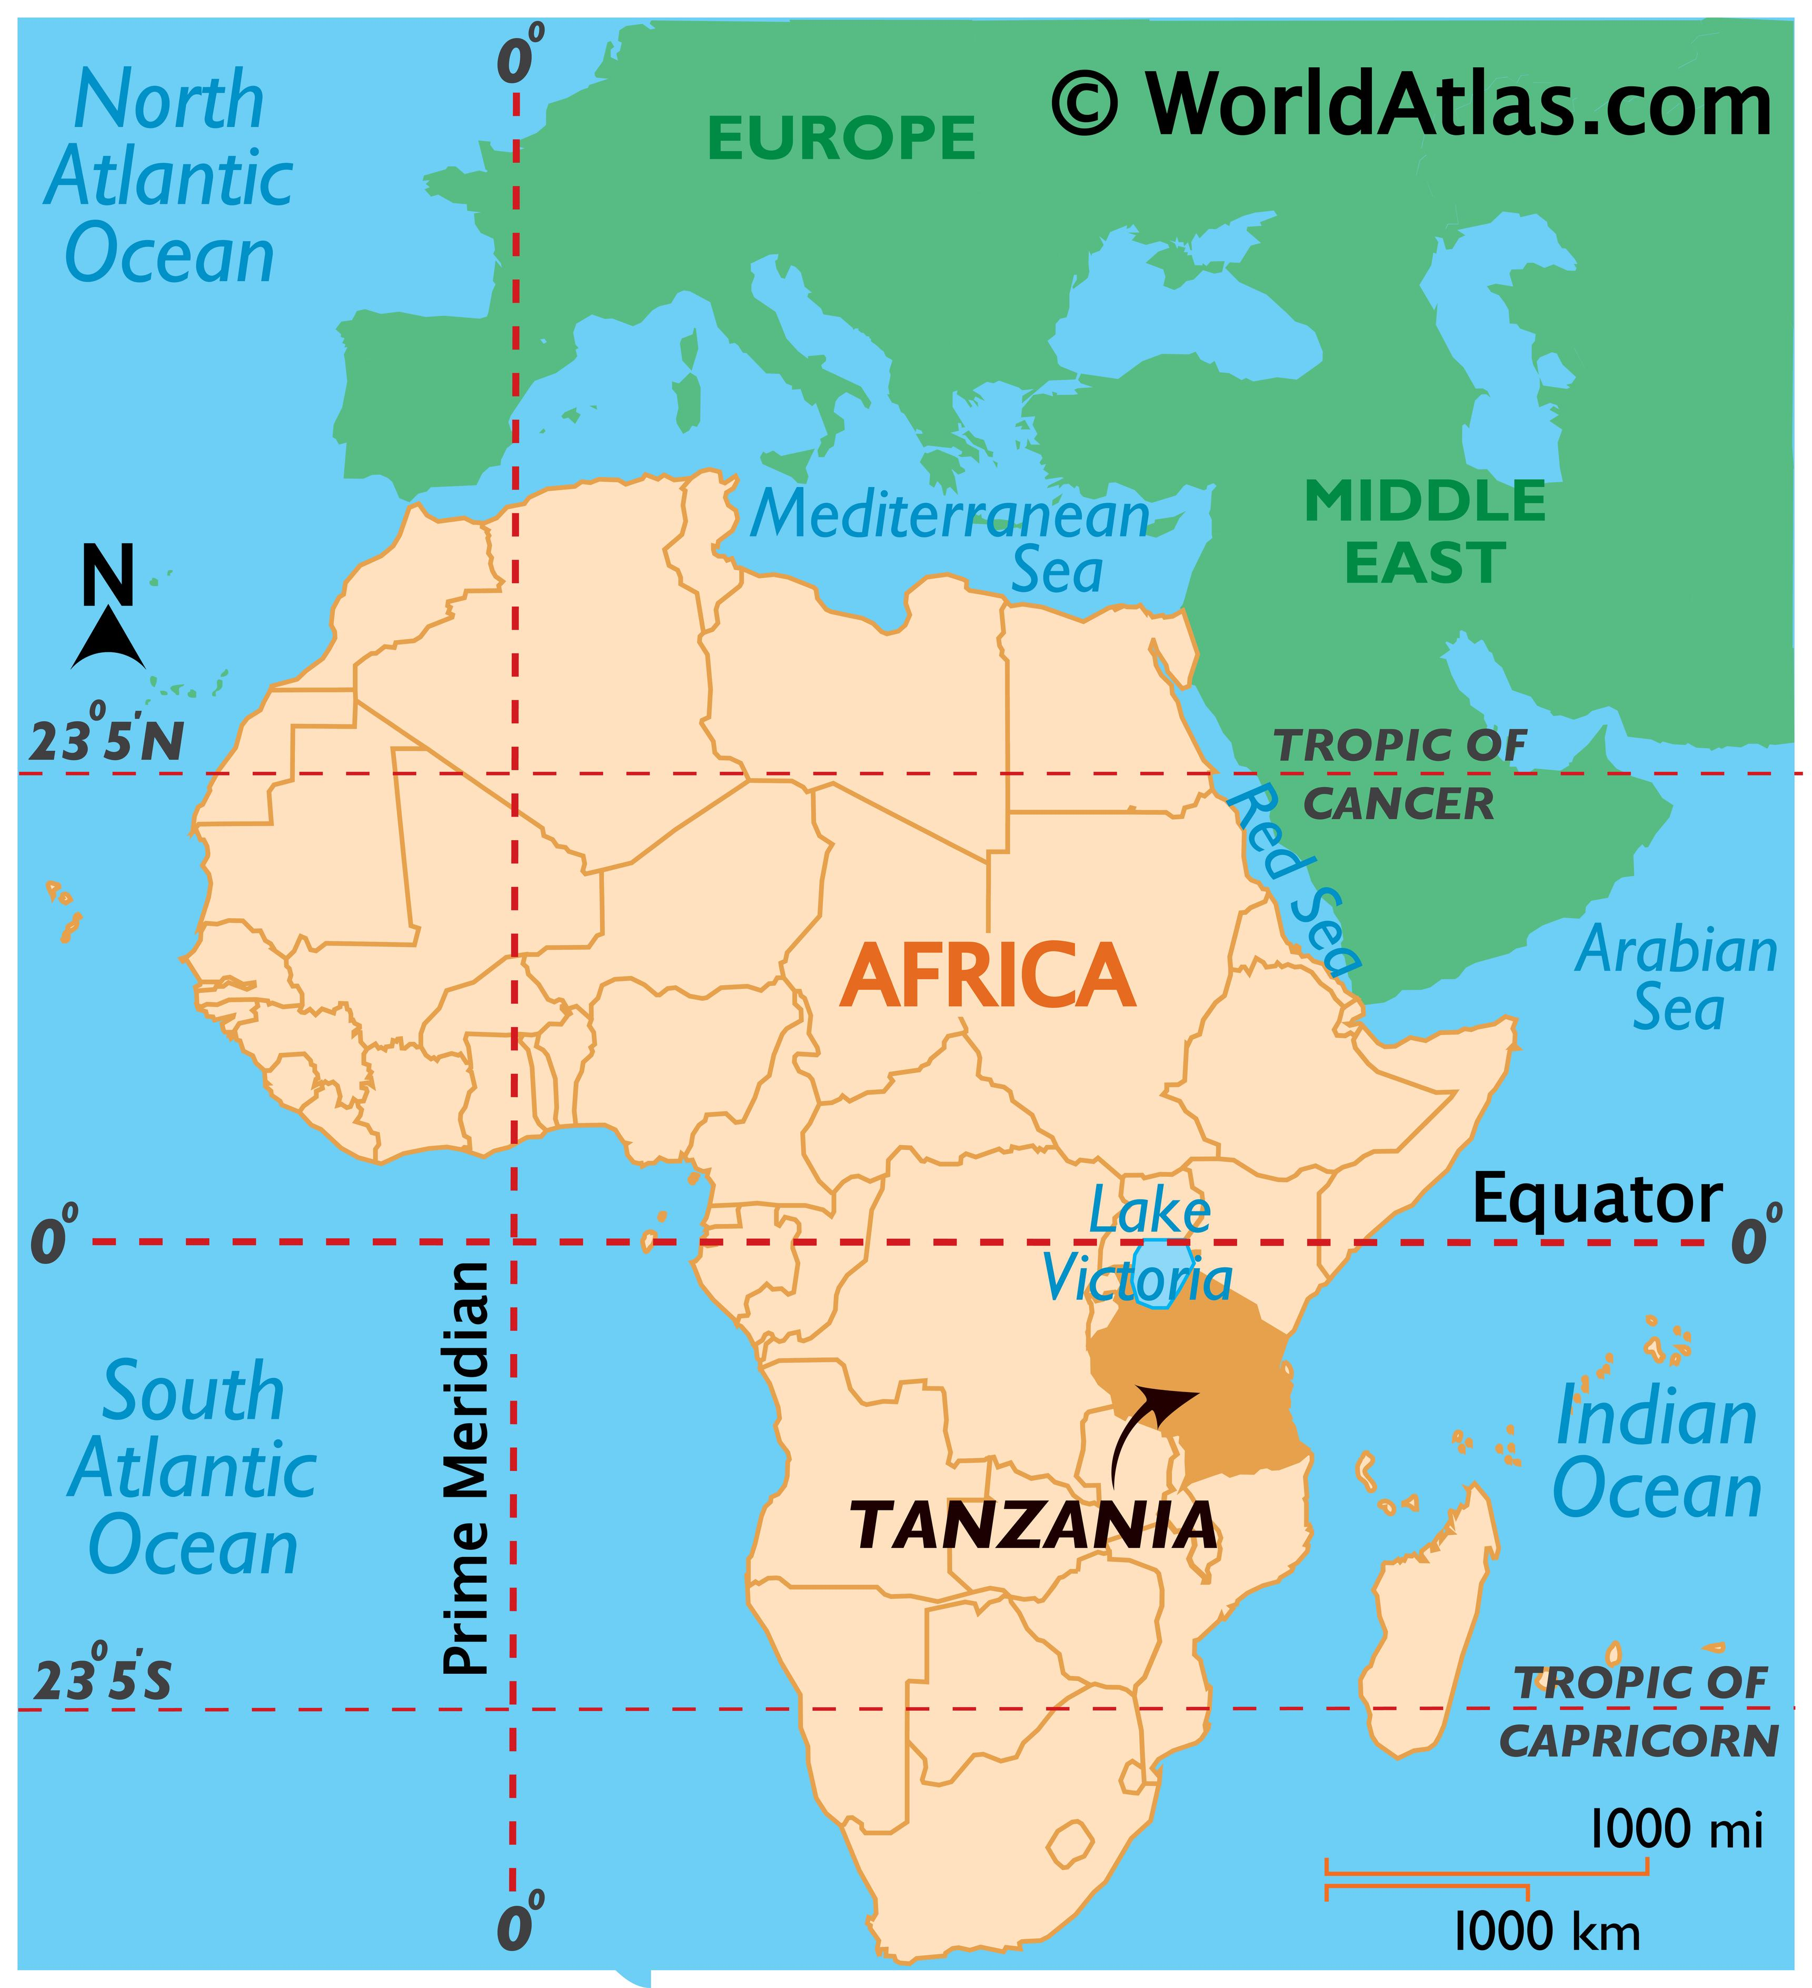
CCHF
Recent Outbreaks:
Tanzania January-March, 2025: 10 confirmed & probable cases all resulted in deaths
Iraq, July-Sept 2025: 114 cases with 12 deaths
Tanzania Maps & Facts - World Atlas
Notes:
All facilities which are not specifically designated as a level 2 or 3 are by default level 4s and need to be able to identify, isolate, inform, and initiate stabilizing medical care; protect team members; and arrange timely patient transport.
If your hospital is accredited by The Joint Commission, please know that there were two new standards specific to special pathogens which were set in mid 2024.

Slide 35
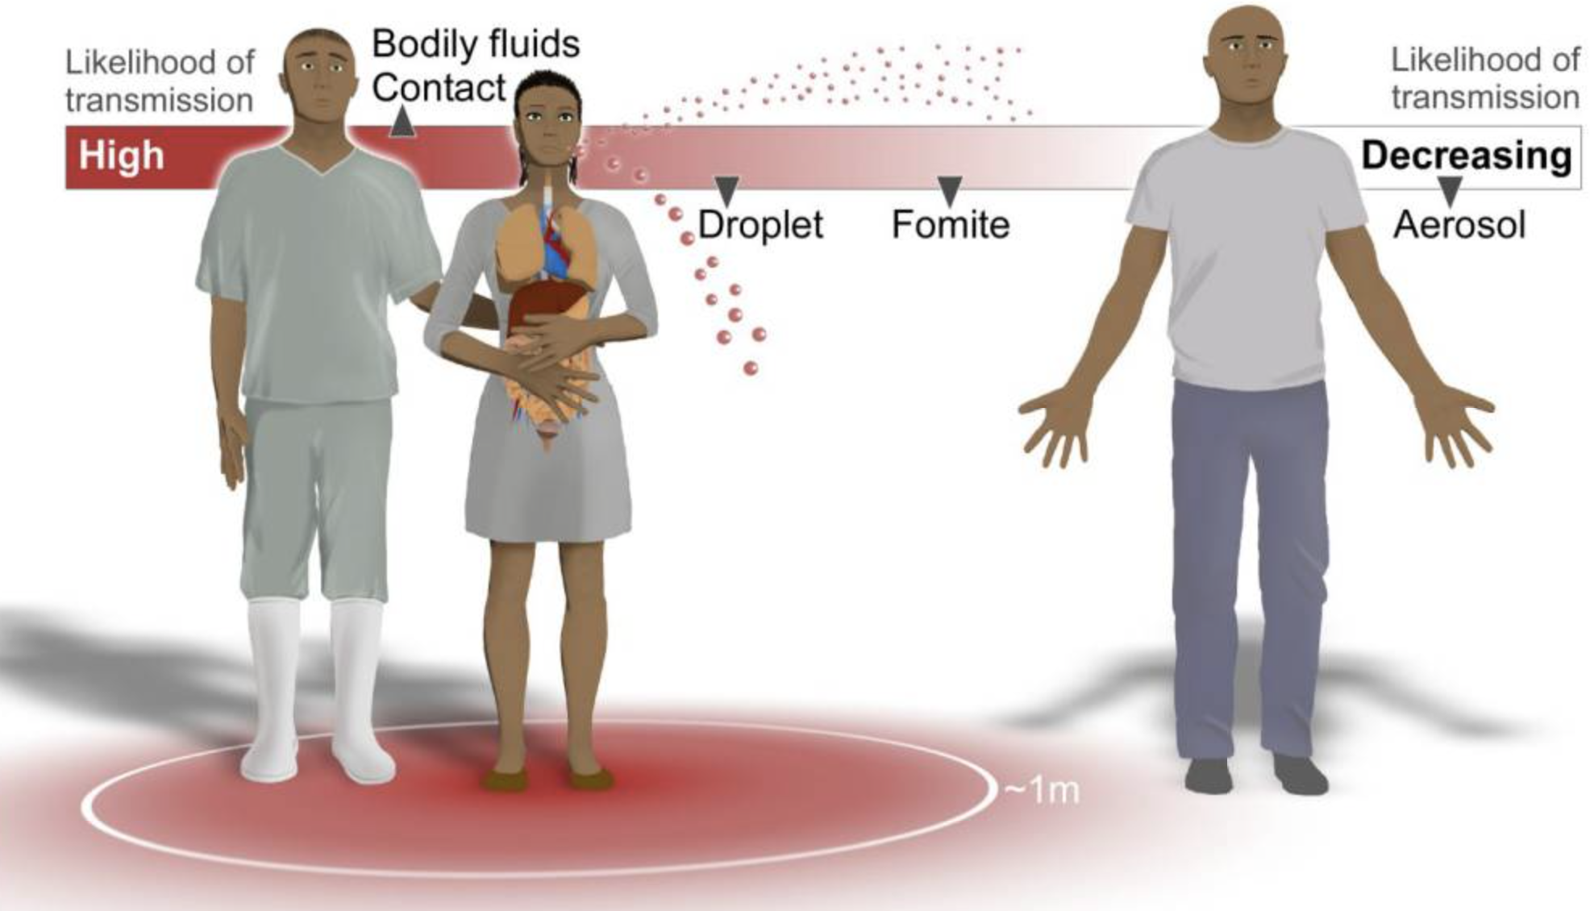
VHF Transmission
Notes:
All facilities which are not specifically designated as a level 2 or 3 are by default level 4s and need to be able to identify, isolate, inform, and initiate stabilizing medical care; protect team members; and arrange timely patient transport.
If your hospital is accredited by The Joint Commission, please know that there were two new standards specific to special pathogens which were set in mid 2024.

Slide 36
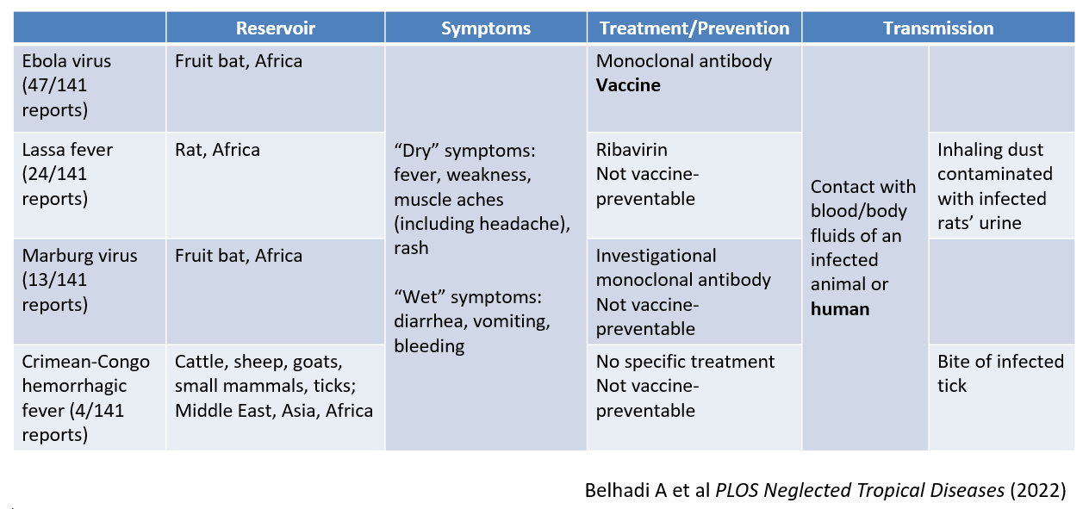
VHF Study
Notes:
All facilities which are not specifically designated as a level 2 or 3 are by default level 4s and need to be able to identify, isolate, inform, and initiate stabilizing medical care; protect team members; and arrange timely patient transport.
If your hospital is accredited by The Joint Commission, please know that there were two new standards specific to special pathogens which were set in mid 2024.

Slide 37
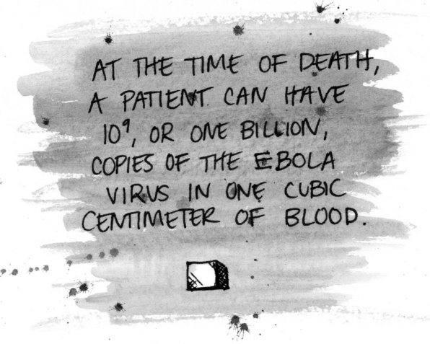
Notes:
All facilities which are not specifically designated as a level 2 or 3 are by default level 4s and need to be able to identify, isolate, inform, and initiate stabilizing medical care; protect team members; and arrange timely patient transport.
If your hospital is accredited by The Joint Commission, please know that there were two new standards specific to special pathogens which were set in mid 2024.

Slide 38
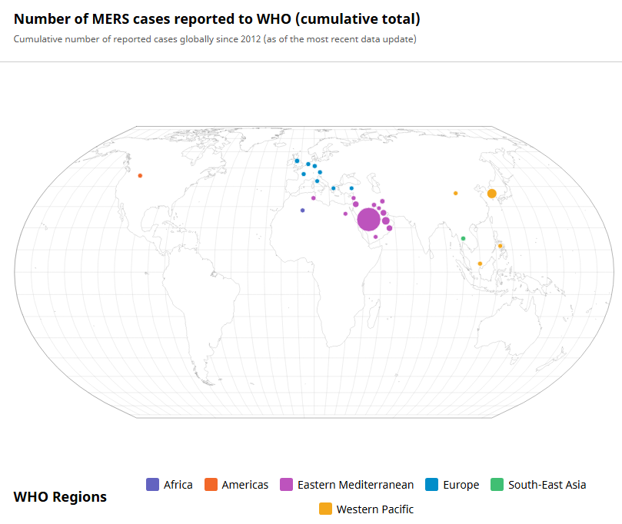

Middle East Respiratory Syndrome (MERS)
35%
Case Fatality Rate
What is MERS?
Caused by MERS-CoV and transmitted by camels and people.
Signs and Symptoms
Symptoms usually appear 2-14 days after a person is exposed. Common symptoms include fever, headache, non-productive cough, dyspnea, chills and myalgia.
Advanced symptoms include rapidly progressive pneumonitis, acute respiratory distress syndrome (ARDS), acute kidney injury, hepatitis, and septic shock.
WHO: MERS Cases
Notes:
All facilities which are not specifically designated as a level 2 or 3 are by default level 4s and need to be able to identify, isolate, inform, and initiate stabilizing medical care; protect team members; and arrange timely patient transport.
If your hospital is accredited by The Joint Commission, please know that there were two new standards specific to special pathogens which were set in mid 2024.

Slide 39
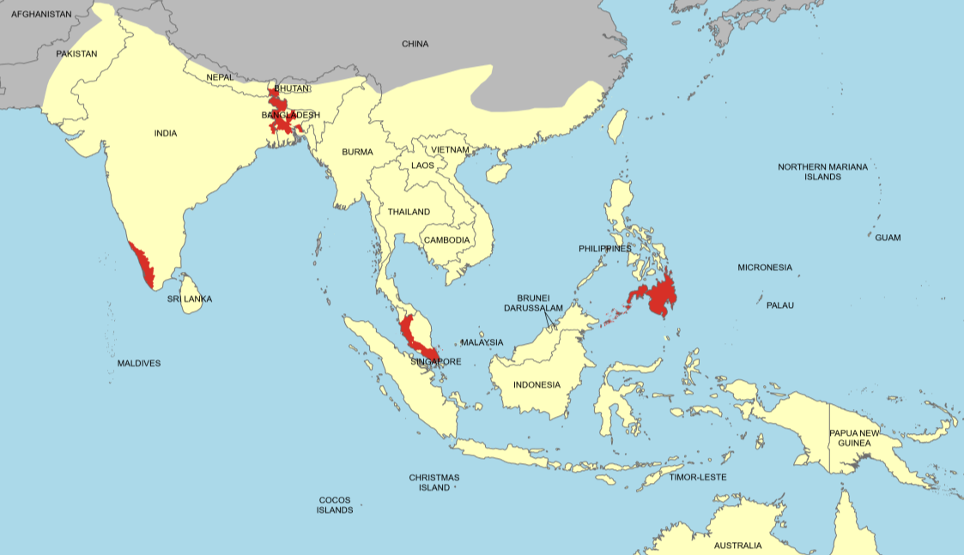
Nipah Virus
What is Nipah?
A viral disease spread by fruit bats and can be spread person to person. It is found in Asia.
Signs and Symptoms
Symptoms usually appear 3-14 days after a person is exposed. Common symptoms include fever, headache, cough, sore throat, and difficulty breathing.
Advanced symptoms include encephalitis, drowsiness and seizures. Coma can occur within 24-48 hours of these symptoms presenting.
Fruit bat presence (yellow) and Nipah outbreaks (red)
About Nipah Virus | Nipah Virus | CDC
40-70%
of people with Nipah die
Notes:
All facilities which are not specifically designated as a level 2 or 3 are by default level 4s and need to be able to identify, isolate, inform, and initiate stabilizing medical care; protect team members; and arrange timely patient transport.
If your hospital is accredited by The Joint Commission, please know that there were two new standards specific to special pathogens which were set in mid 2024.

Slide 40
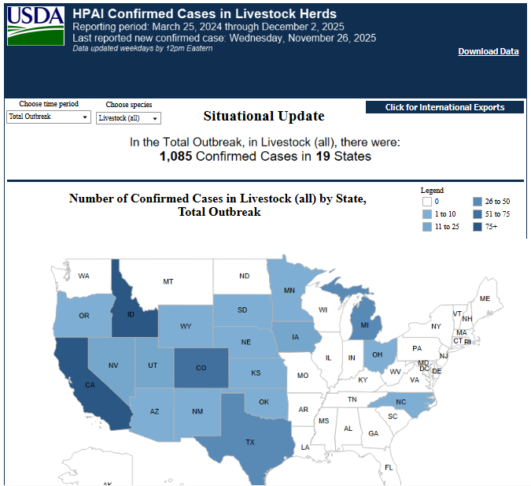
Highly Pathogenic Avian Influenza
What is H5N1?
Avian influenza A infects respiratory and GI tracts of birds- can be transmitted to humans through eyes, nose, mouth, or inhalation.
H5N1 has been reported in wild mammals such as foxes, bears, sea lions, and domesticated animals such as goats, dairy cows and pets.
Signs and Symptoms
Symptoms usually appear 1-10 days after a person is exposed. Mild illness: cough, sore throat, conjunctivitis, fever, fatigue, headache. Moderate to severe: difficulty breathing, altered mental status, seizures. Complications include pneumonia, respiratory failure, ARDS, multi-organ failure, sepsis & meningoencephalitis.
No H5N1 vaccine is currently available. Chemoprophylaxis with influenza antivirals is available for high risk exposures.
>50 %
case fatality
Notes:
All facilities which are not specifically designated as a level 2 or 3 are by default level 4s and need to be able to identify, isolate, inform, and initiate stabilizing medical care; protect team members; and arrange timely patient transport.
If your hospital is accredited by The Joint Commission, please know that there were two new standards specific to special pathogens which were set in mid 2024.

Slide 41
Identify, Isolate & Inform
PREPARE. PROTECT. RESPOND.

Slide 42
Key Concept of Care
Identify
Screening mechanism in place
Standardized process for positive HCID screening
Isolate
Patient dons mask, placed in private room
PPE for staff
Waste management
Inform
Organizational workflow Chain of Command
Notes:
Identify
Patient could have potential HCID
Preparedness Considerations:
What screening mechanisms does my organization use to assess symptoms and travel? What about occupational or hobby exposures?
Do you have ability to edit screening questions? How is that list updated?
Does staff know what process to follow, if screening is positive for potential HCID?
If workplace is a point of entry, how long may this patient wait in common spaces before being screened?
Isolate
Patient dons mask
Patient is placed in private room with door closed, preferably negative pressure
Staff don appropriate PPE
Preparedness Considerations:
Do you have masks and eye protection at the registration desk for staff?
Once patient is identified, where will they placed?
What supplies are needed for the patient to isolate for up to 8 hours? (Consider commode with solidifier if no toilet in isolation room.)
If VHF is suspected, how will Cat A waste be managed? Does staff have access to full barrier PPE?
Inform
Follow organizational workflow for chain of command:
Organization’s Infection Prevention Department
Responsible provider
Local Health Department
Preparedness Considerations:
Does your organization have an established chain of command for HCID notification?
Do frontline staff know who to contact if HCID is suspected?

Slide 43
Identify, Isolate, Inform
How do you determine where the outbreaks are? Here are some resources
CDC Travel Health Notices - https://wwwnc.cdc.gov/travel/notices
WHO Disease Outbreak News (DONs) - https://www.who.int/emergencies/disease-outbreak-news
NYC Health & Hospitals Travel Screening Country List - https://www.nychealthandhospitals.org/institute-for-disease-and-disaster-management/travel-and-exposure-screening-resources/
Notes:
Preparedness Considerations:
What screening mechanisms does my organization use to assess symptoms and travel? What about occupational or hobby exposures?
Do you have ability to edit screening questions? How is that list updated?
Does staff know what process to follow, if screening is positive for potential HCID?
If workplace is a point of entry, how long may this patient wait in common spaces before being screened?

Slide 44

Identify, Isolate, Inform
Another resource to look for current threats is the Biothreats Emergence, Analysis and Communications Network (BEACON) https://www.bu.edu/ceid/projects-partnerships/beacon/
BEACON is a first-of-its-kind, open-source global surveillance platform built to detect emerging infectious diseases in near real time, worldwide. The platform merges the power of artificial intelligence (AI) with a global network of human subject matter experts to provide fast, verified alerts to potential outbreaks.
Notes:
Preparedness Considerations:
What screening mechanisms does my organization use to assess symptoms and travel? What about occupational or hobby exposures?
Do you have ability to edit screening questions? How is that list updated?
Does staff know what process to follow, if screening is positive for potential HCID?
If workplace is a point of entry, how long may this patient wait in common spaces before being screened?

Slide 45
Identify, Isolate, Inform
The initial step is to promptly identify patients who may have a high-consequence infectious disease.
The key is to screen for specific symptoms and epidemiologic risk factors, such as recent travel history or contact with known cases.
Notes:
Preparedness Considerations:
What screening mechanisms does my organization use to assess symptoms and travel? What about occupational or hobby exposures?
Do you have ability to edit screening questions? How is that list updated?
Does staff know what process to follow, if screening is positive for potential HCID?
If workplace is a point of entry, how long may this patient wait in common spaces before being screened?

Slide 46
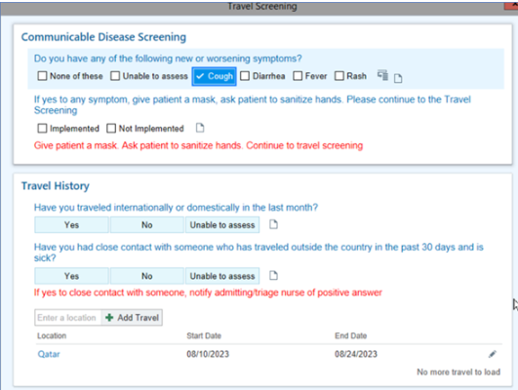
Identify, Isolate, Inform
Utilize the electronic healthcare record
  Standard Option
  Custom Build
Notes:
The example being shown is pulled from EPIC.
Disease and travel screen can be custom built to track infections in the CDC Current Outbreak List
Another resource to look for current threats is the Biothreats Emergence, Analysis and Communications Network (BEACON) https://www.bu.edu/ceid/projects-partnerships/beacon/
BEACON is a first-of-its-kind, open-source global surveillance platform built to detect emerging infectious diseases in near real time, worldwide. The platform merges the power of artificial intelligence (AI) with a global network of human subject matter experts to provide fast, verified alerts to potential outbreaks.
It is extremely IMPORTANT that the travel and communicable disease screening tool be filled out for EVERY. PATIENT. EVERY. VISIT. To ensure that visitors and team members are not exposed.

Slide 47
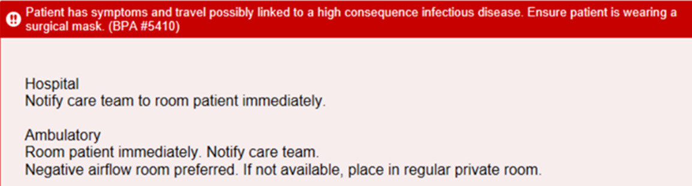
Identify, Isolate, Inform
Notes:
This Best Practice Advisory (BPA) will pop up and alert the team when a patient is suspected of having a high consequence infectious disease and direct the team member to the appropriate isolation steps.

Slide 48
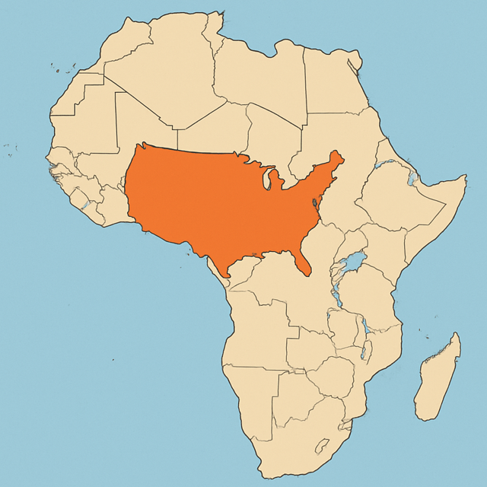
Specific Locations Visited Are Important

Slide 49
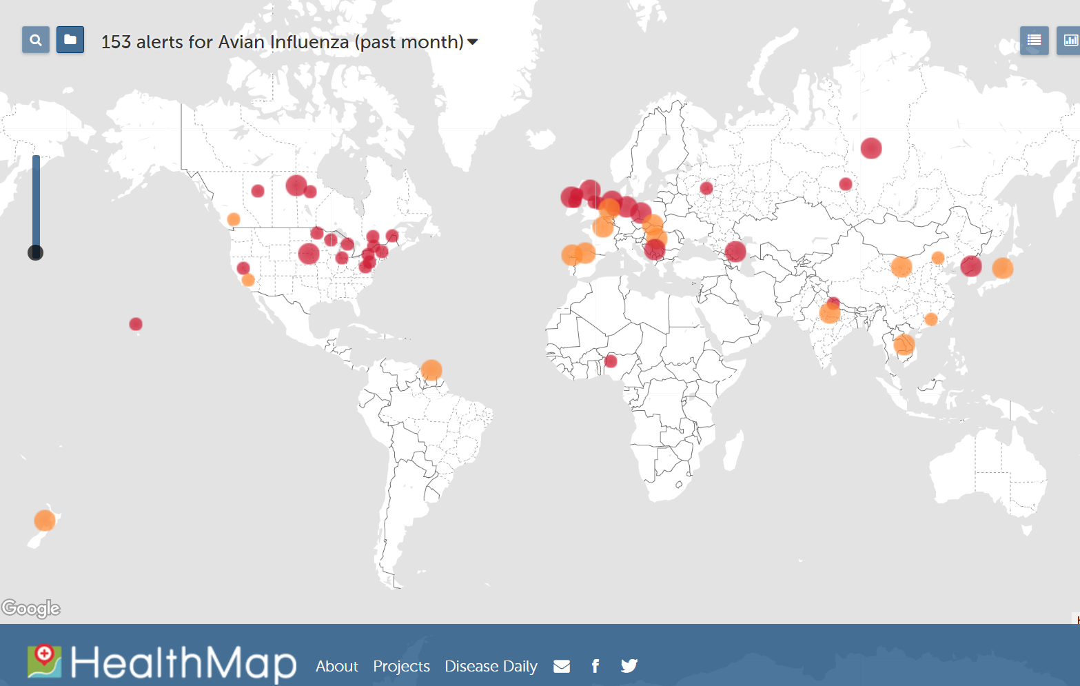
Flu & Ebola Map | Virus & Contagious Disease Surveillance

Slide 50
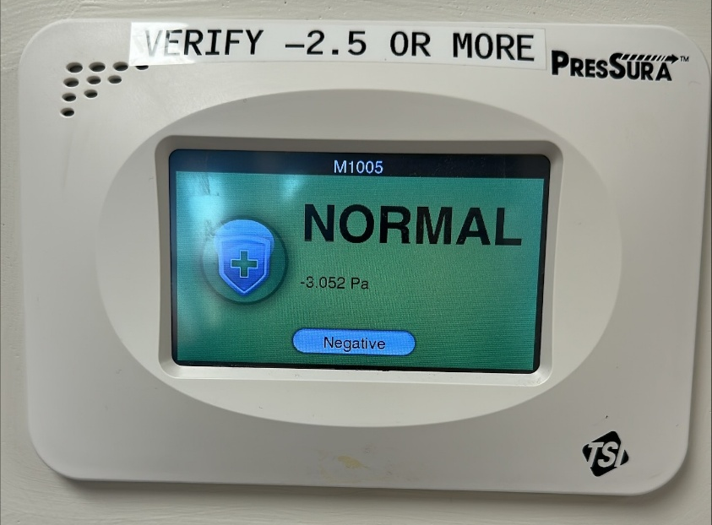
Identify, Isolate, Inform
Patient dons a mask to reduce the risk of transmission.
Patient is placed in private room with door closed, preferably negative pressure.
Staff don appropriate PPE.

Slide 51
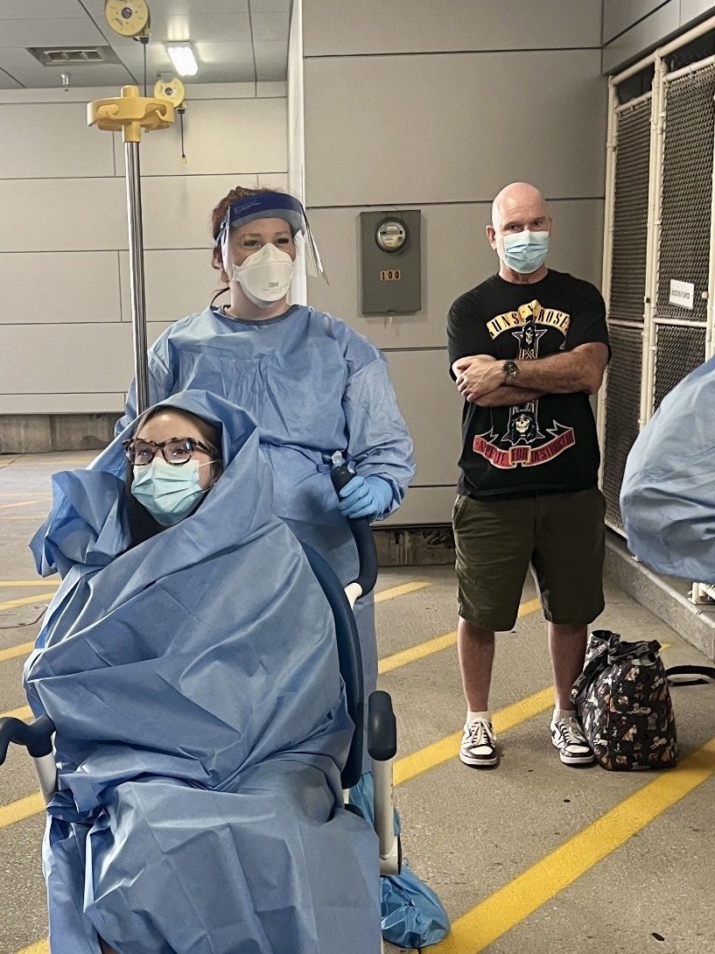
Identify, Isolate, Inform
Considerations
What do you do if you do not have an airborne isolation room available?
What if the patient arrived with a visitor? Does your approach change if the visitor is displaying symptoms
Notes:
If no airborne isolation room is available, the patient can be placed in a regular private room with the door closed.
If the patient has a visitor with them, they should also be screened for symptoms. If no symptoms, then the visitor should be masked and remain that way but can stay with the patient until told otherwise by the healthcare provider. If the visitor also has recent travel and symptoms like the patient, they should be triaged and assessed separately.

Slide 52

Identify, Isolate, Inform
After isolation, it is essential to notify the appropriate authorities—hospital infection control and local or state public health departments.
Timely reporting enables contact tracing, implementation of community protection measures, and access to critical resources and support.

Slide 53
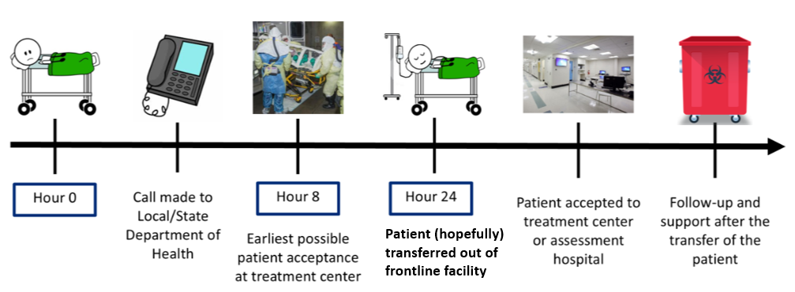
Identify, Isolate, Inform
Notes:
Here is an example of what the entire process can look like for a frontline facility.
Hour 0 – patient arrives at a hospital, then calls are made to hospital infection prevention, infectious disease, local/state public health department. The health department’s role is to coordinate with CDC (if necessary) and do a deeper dive into patients background, travel history, and potential exposure risk. If the CDC is looped in and they determine there is a reasonable possibility the patient may have a special pathogen, then it is communicated back to the state health department to begin working on a transfer plan to an assessment or treatment center.

Slide 54

Great Lakes Healthcare Partnership
The GLHP's primary goal is to enhance the region's ability to respond to and recover from significant incidents and emergencies that impact healthcare delivery.​
​
The GLHP works on developing and sharing emergency preparedness plans, resources, and best practices, and fosters collaboration among healthcare organizations and emergency management agencies ​

Slide 55
Great Lakes Healthcare Partnership​
Frontline Facility will:​
Expect to care for patient for a minimum of 8 hours.​
Log staff contacts with patient, specimens, and waste.​
Sequester waste in preparation for removal.​
Escalate any operations/logistics questions to health department; patient care questions to RESPTC/NETEC.​

Slide 56
Great Lakes Healthcare Partnership
Health Department may:​
Held arrange transport/ambulance service. Will include police transport if needed.​
Identify/Notify potential receiving hospital(s).​
Will notify/contact ASPR/HHS, CDC, other state health departments if needed.​
Discuss testing process/lab work and transporting sample to state public health lab for presumptive positive. ​
Connect Frontline Facility to receiving hospital and/or RESPTC/NETEC for support.

Slide 57
What will they ask?
  Provide Situational Report:
    Personal information
      Name, age, gender, pregnancy status, suspected/confirmed HCID
    Countries visited and dates of travel in each
    Symptoms / Condition
      Stable, improving, or worsening
      List of symptoms and onset dates
    A description of exposure (examples: animal exposures, healthcare exposures, etc.)
    Confirm that blood was drawn and where it was sent off for testing and for what pathogens

Slide 58

State Primary Points of Contact:
    Wisconsin: 24/7 Communicable Disease On-Call: 800-943-0003

Slide 59
SPU- Hosted & Regional Education
PREPARE. PROTECT. RESPOND.

Slide 60
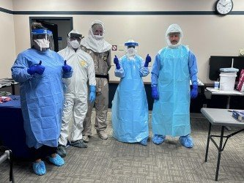
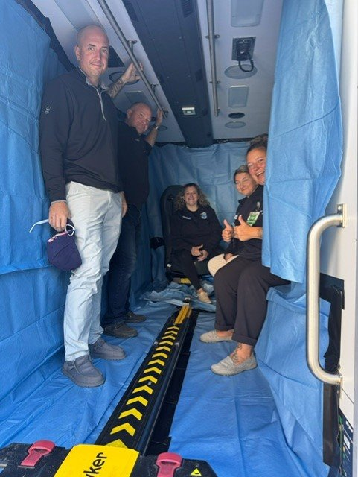
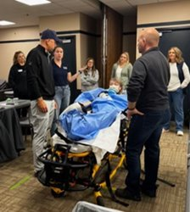
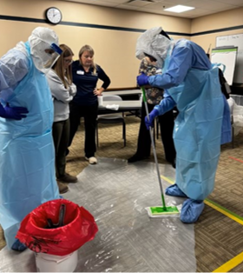
Full-Day HCID Training
Agenda:
NSPS & RESPTC Overview
Special Pathogen Review
Identify, Isolate, Inform
First Responder Considerations
Wrapping a Patient for Transport
PPE Considerations (PPE Selection, donning & doffing, breach management)
Category A Waste Management
Case Study

Slide 61
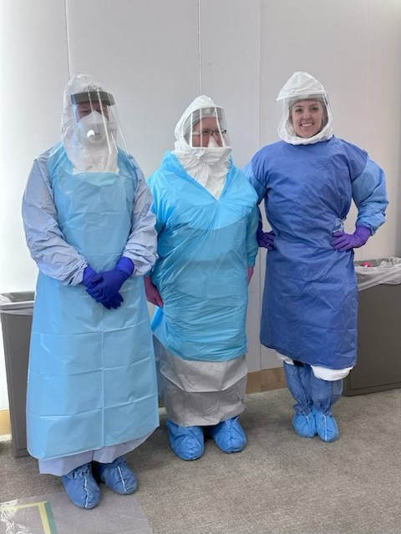
Key Takeaways
Provided guidance on PPE ensembles for several organizations Participants encouraged to bring their own PPE from Guidance focusing on using the supplies available (patient wrap vs expired Isopod or using PPE currently in their system.) Overall favorable evaluations with attendees reporting increased confidence in HCID related skills and knowledge Organizations report increased knowledge related to outbreak tracking resources

Slide 62
NSPS In Activation
PREPARE. PROTECT. RESPOND.

Slide 63
Special Pathogen Recent Event – Lassa Fever
October 2024, An American citizen returned from Liberia to their home in Iowa. ​
Patient was not symptomatic during travel ​
8 days after his return presented to local emergency department with fever, headache, and myalgia. ​
Symptoms did not trigger the travel screen within the electronic healthcare record. ​
Patient lived in a single multi-generational home

Slide 64



NSPS in Activation – Lassa Fever
Context
An American citizen, returned from Liberia, was cared for at 3 different healthcare facilities in Iowa, and eventually succumbed to Lassa Fever.
5
Healthcare facilities involved
172
EMS & healthcare workers exposed
Zero
Transmitted infections due to PH & NSPS success

Slide 65




Timeline of Events
NOV 3-NOV 20
5 individuals under monitoring develop s/s that warrant Lassa testing. EMS transports to Hospitals C and D.
All tests (-)
IA PHL onboards GFSP
OCT 27
Y w/ progressing hypotension, MODS. ID assessment raises Lassa fever concern. IA public health contacted. RESPTC contacted and response team deployed.
OCT 22
Y presents to emergency department
EMS transport to Community Hospital B. Abx started, malaria (-)
OCT 29
Contact tracing. 180 contacts at 3 med facilities, 3 EMS, 5 labs, family, and community
OCT 7
Patient (Y) returns to Iowa from Liberia
OCT 28 (0100)
BioFire GFSP positive for Lassa.
OCT 15
Y develops fever, headache, myalgia
OCT 26
EMS transport from Hosp B to Hosp C w/ worsening delirium and VS. Direct admit to ICU
OCT 27
Test sent to NE Public Health Laboratory
OCT 28
Patient expires. RESPTC team on site. Remains prepared for cremation.
OCT 29-NOV 3 RESPTC teams provide assistance on site at hospitals and EMS agencies in Des Moines and Eastern Iowa
NOV 20
Contact tracing winds down. No secondary cases

Slide 66
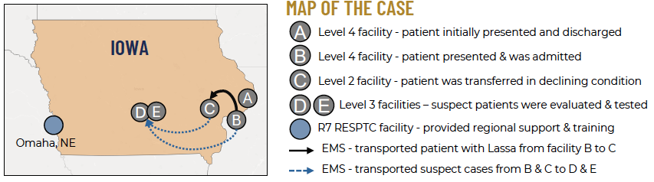
Map of the Lassa Case

Slide 67



How the NSPS Successfully Responded
Elements of Preparedness & Response
“Our success [in response] was because of the groundwork that was laid over the past decade.” – NETEC Leader
Prepared to Activate
IA hospitals & EMS practiced similar scenarios together and with the Level 1 in Omaha
NETEC facilitated national coordination & real-time information sharing
Level 1 or RESPTC to provided just-in-time training, technical assistance, & regional coordination
Long-Standing Relationships
Partners in Region 7 built a foundation of trust that enabled quick coordinated response
Level 2 & 3 collaborated with NSPS partners and cared for confirmed patient & suspect patients
EMS provided transport
for patients & suspect cases to higher levels of care and for assessment & testing
NSPS Coordination
All levels of the NSPS, from Level 1-4 and EMS, coordinated a rapid, united response

Slide 68



The Catastrophic Risk
What could’ve happened if we weren’t prepared…
Health-Worker Shortage
Over 150+ healthcare workers were exposed, threatening health-worker shortages at rural facilities
Breakdown of 911 Services
EMS personnel were exposed, with the potential to overwhelm & breakdown 911 and EMS services
Rural Community Impact
Est. 170 individuals were exposed, risking health system overload, severe socio-economic disruptions, and lives lost.

Slide 69
Closing/Questions

Slide 70


Resources
Region V RESPTC Regional Outreach Program (UMMC in Minneapolis, MN and Corewell Health in Grand Rapids, MI)
  Special Pathogens Support: Intake Form
  Have questions? Email DEPT-UMMC-SPU@Fairview.org or SPU@corewellhealth.org
National Emerging Special pathogens Training and Education Center (NETEC)
  https://netec.org
Questions:
Newsletter Subscription:

