Slide 1

Introduction to a trauma program
Region 1-Northwest Wisconsin RTAC
Notes:
This PowerPoint covers the basic information needed to get started if you are a new trauma registrar or trauma program manager.

Slide 2
Content Outline
DHS Website/Resources
Inclusion Criteria
Trauma Registry
Identifying the Trauma Patients/Trauma Log
Performance Improvement
Audit Filters
Mortality Classification
Loop Closure
Report Writer
Meetings-RTAC and STAC
Trauma Site Visit
Notes:
The powerpoint will cover the above topics.

Slide 3
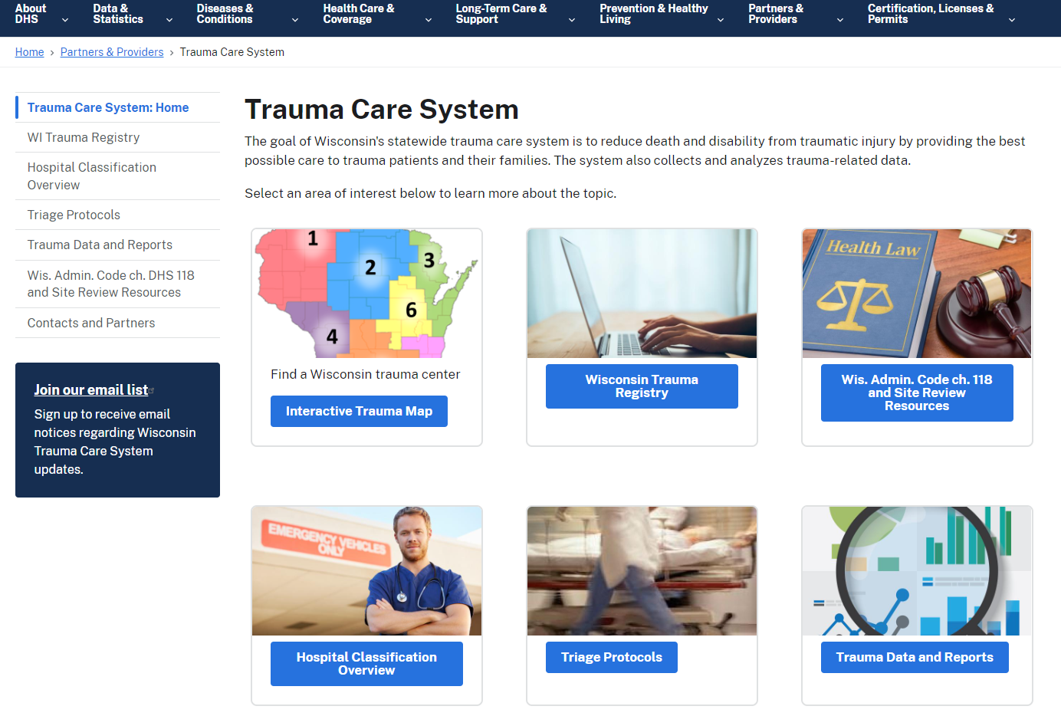
Wisconsin department of Health Services (DHS)
Trauma Care System
https://www.dhs.wisconsin.gov/trauma/index.htm
Notes:
Our statewide trauma system is managed by the Department of Health Services (DHS). On the DHS website you will find links to the trauma registry, protocols, trauma data and reports, the DHS 188, which is the standards in which your hospital needs to follow, in addition to several other resources.

Slide 4

Inclusion Criteria-
Who Should go into the Registry?
Notes:
Wisconsin State Trauma Registry Data Dictionary

Slide 5
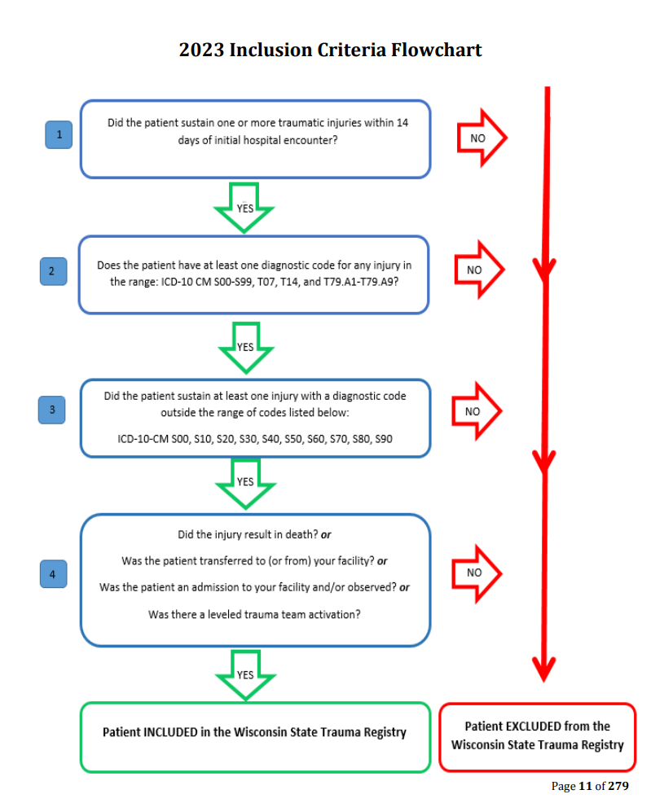
Inclusion Criteria
Admitted
Transferred
Died
(Have to have a qualifying injury)
All trauma activation patients
Notes:
The patients who will go into your trauma registry include patients who have been admitted, transferred, or died that have a qualifying mechanism and injury. See the flowchart above. In addition, you should be tracking all of your trauma activations in the registry even if they were discharged home from the ED so you can evaluate your over/under triage as well as keep accurate statistics on your trauma volume.

Slide 6

Trauma Registry
Notes:
Wisconsin State Trauma Registry Data Dictionary

Slide 7
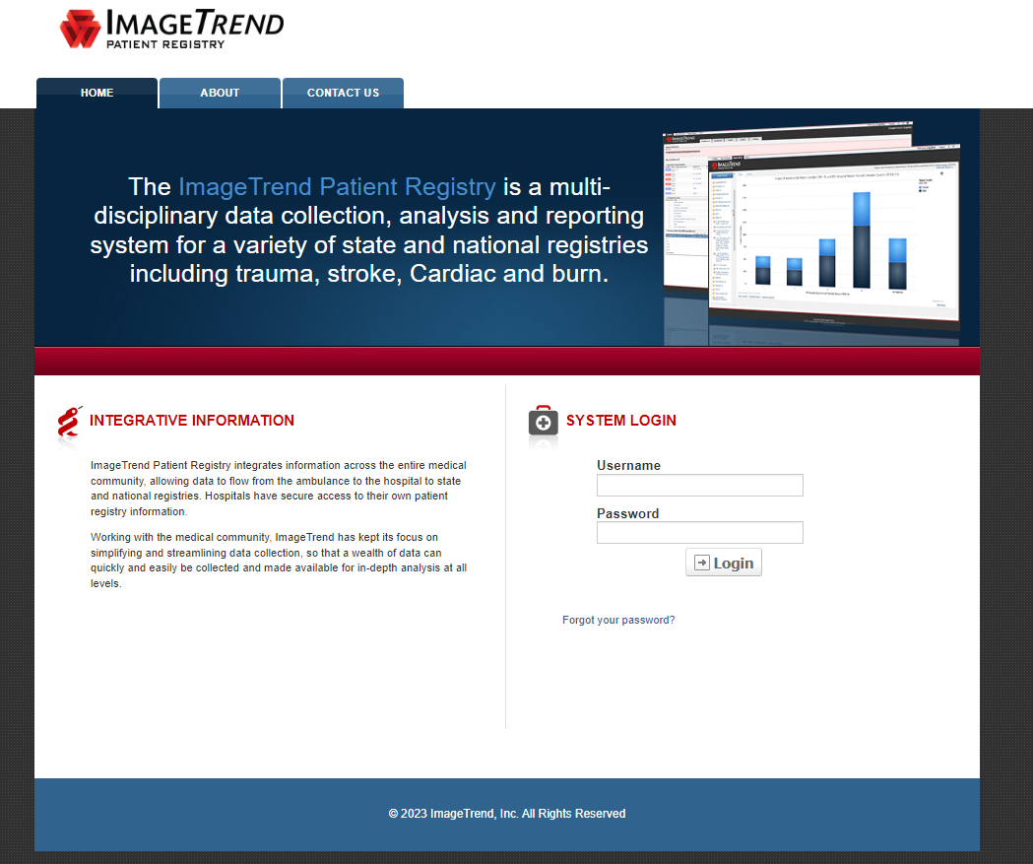
Trauma Registry
Registry Link
https://wisconsintrauma.imagetrendregistry.com/
Registry Access Form
https://www.dhs.wisconsin.gov/forms/f01885.pdf
Notes:
The registry you will use for entering your data is a web-based program called ImageTrend. You can find the registry links on the DHS website above and the form to be granted access. Training videos are available on the DHS website (links on next slide) or reach out to Kati Prather at DHS. Katie.prather@dhs.Wisconsin.gov

Slide 8
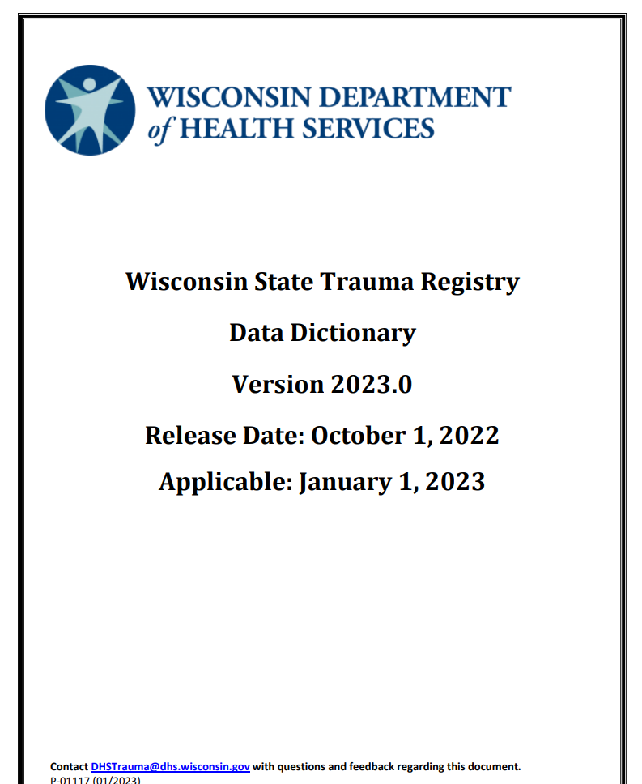
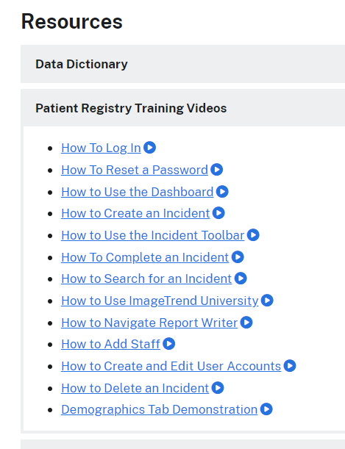
Registry Resources
Notes:
The data dictionary lists the definitions for the elements you will be collecting in the trauma registry. https://www.dhs.wisconsin.gov/publications/p01117.pdf
The resources above on the right are registry training videos. https://www.dhs.wisconsin.gov/trauma/registry.htm

Slide 9
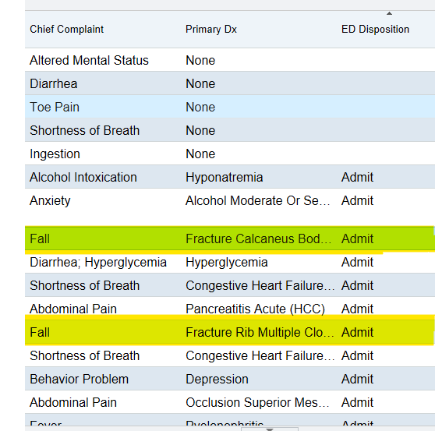
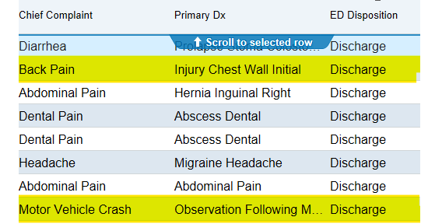
Identifying Trauma Patients
Notes:
How your facility identifies the trauma patients who meet trauma inclusion criteria will depend on what EHR you use and the reports you have available. The screenshots above are from EPIC reports that list all of the patients that entered the ED so we can filter through the list and find those patients who meet trauma activation criteria.

Slide 10
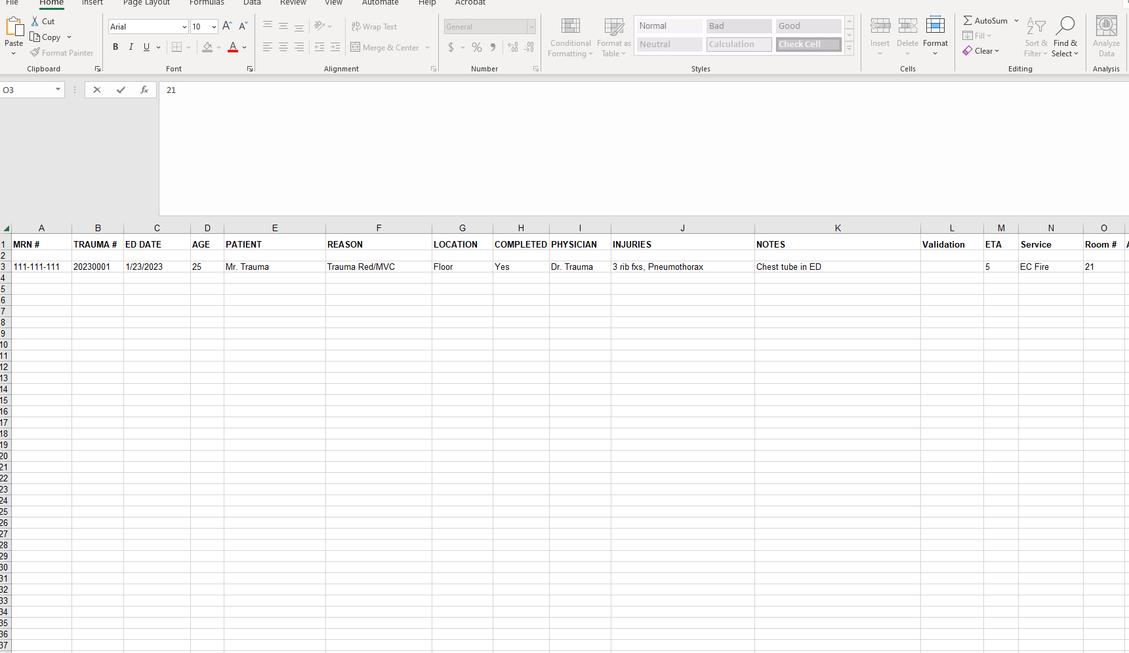
Trauma Log
Notes:
This is one example of a trauma log. When trauma patients are identified, they are placed on a log that contains the above information. Our trauma department team all has access to this report. This is our working document where we can add notes and also mark on the log when the patient is entered and completed in the registry.

Slide 11
Performance Improvement

Slide 12
Primary Review
How are you identifying your patients?
Primary review is often done by the Trauma Program Manager or PI nurse
Have a process to look at every patient
Utilize Audit Filters determined by your organization
Review should be concurrent, can be retrospective, but be timely
Filters can be closed at this level
Notes:
Primary review is done by you, the RN.

Slide 13
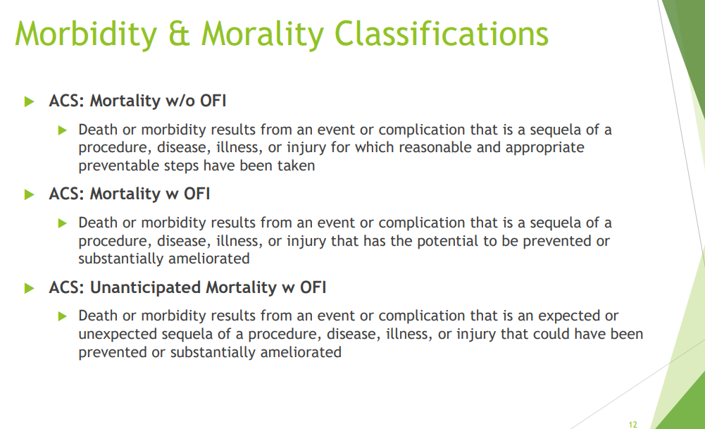
Secondary Review
Secondary Review is often sent to Trauma Medical Director
It may need to be sent for Committee Review:
    Physician Peer Review
    Multidisciplinary Trauma Committee
Not every case needs an action plan
Review all deaths and adverse outcomes
Notes:
The secondary review are those patients you felt needed your trauma medical director to review. On the next slide you will see a list of possible filters for your hospital to use. Make sure all deaths are reviewed and in your multidisciplinary trauma meetings, determine a mortality classification as seen on the lower right.

Slide 14
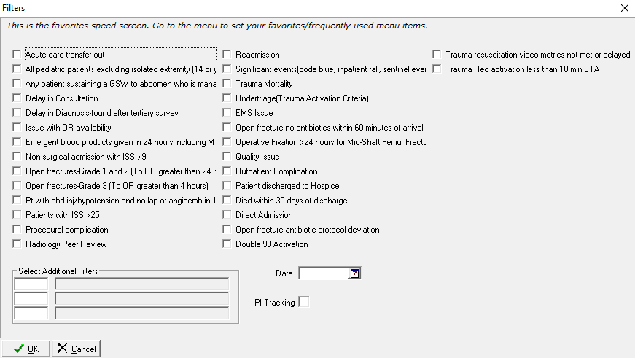
Sample Filters
Notes:
Sample filters your hospital may want to consider. Not all will apply. Each hospital should determine what patients need a review and what can be a primary review vs a secondary review.

Slide 15
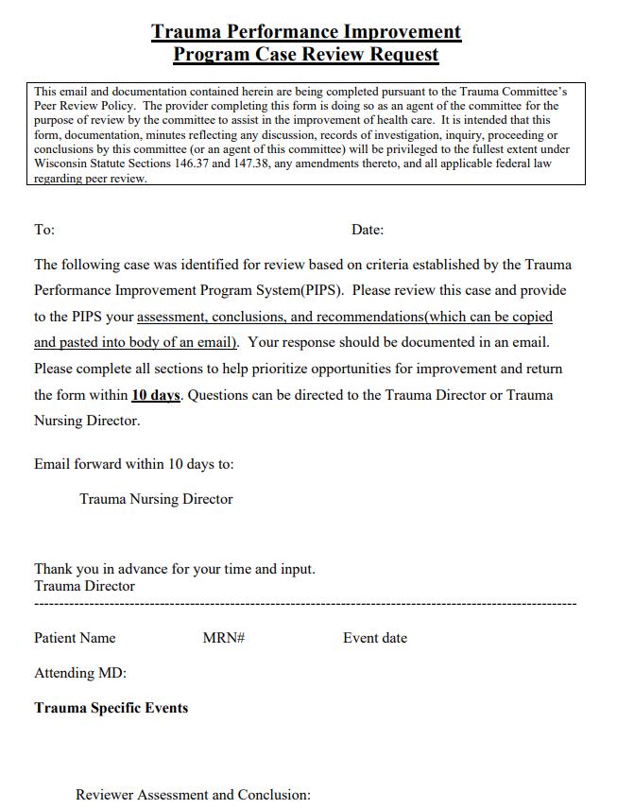
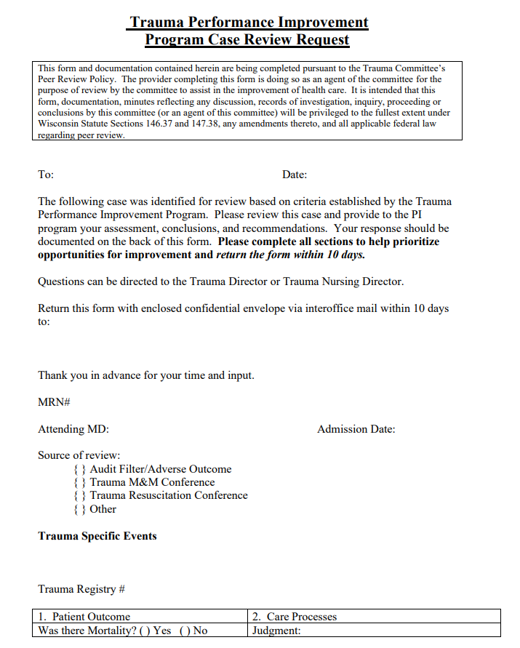
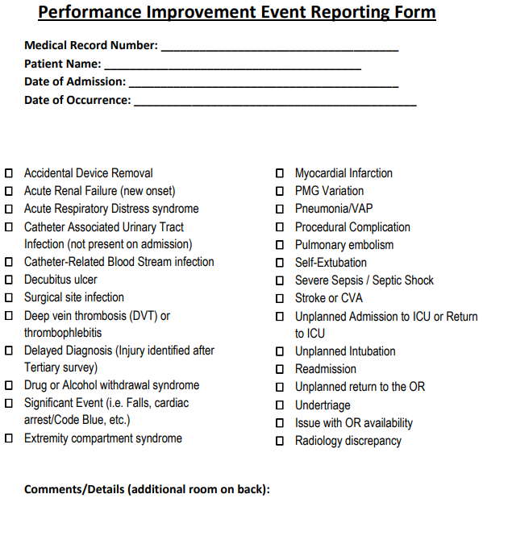
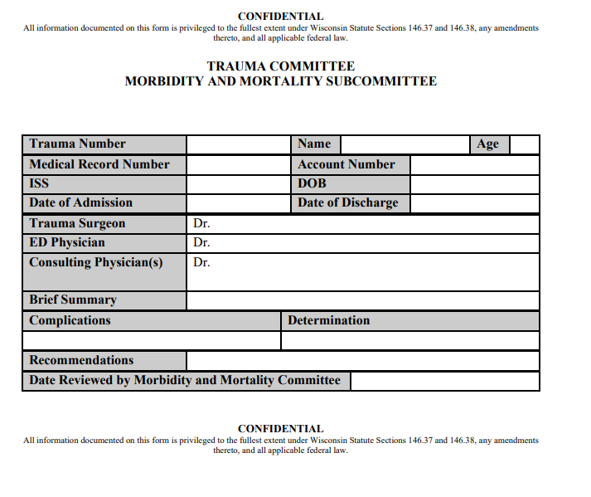
Sample PI Forms
https://www.wiherc.org/nwwirtac.phtml
Notes:
Here are some sample PI forms available for you on our RTAC website. https://www.wiherc.org/nwwirtac.phtml

Slide 16


Key PI Points
All levels of trauma providers have a responsibility for and a role in PI.
The culture of PI needs to be open and transparent.
Make PI nonpunitive is critical.
The motivation for PI should be optimizing the care for the injured patient.
The process of performance improvement needs to be customized to the medical center and providers involved.
Close that loop
Notes:
Closing that loop is a very important and often overlooked component of PI. You identified an issue, but what did you do about it and how are you going to monitor the issue?

Slide 17
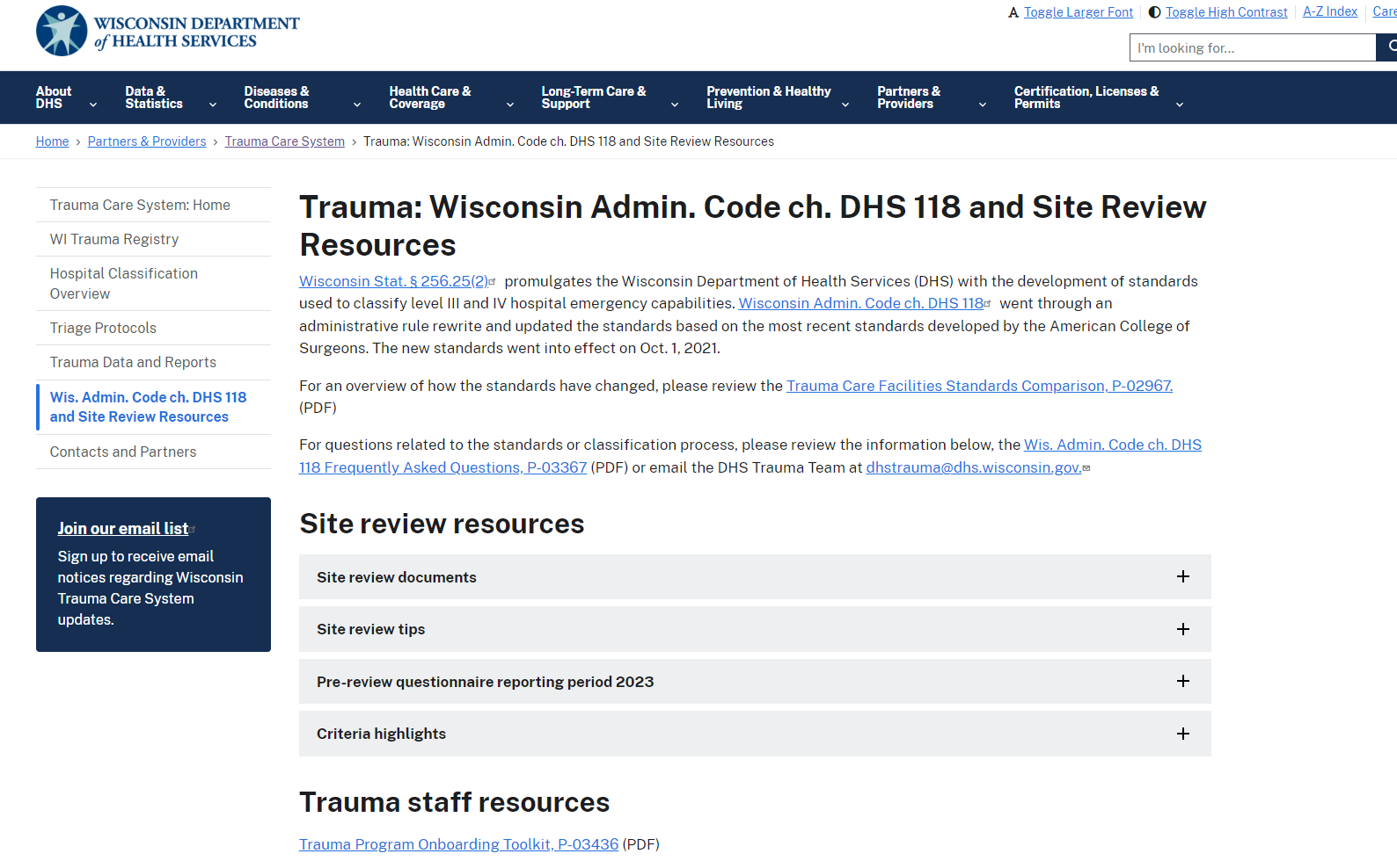
What is a Trauma Site Visit?
https://www.dhs.wisconsin.gov/trauma/dhs-118.htm
Notes:
Every 3 years, your trauma center will be reviewed by a member of the CRC, which stands for classification review committee. Click on the link above to get familiar with DHS 118 (the standards to which you are held to), and other site review documents such as the Pre-Review Questionnaire (PRQ).
FAQ: https://www.dhs.wisconsin.gov/publications/p03367.pdf

Slide 18
Over/Under Triage

Slide 19
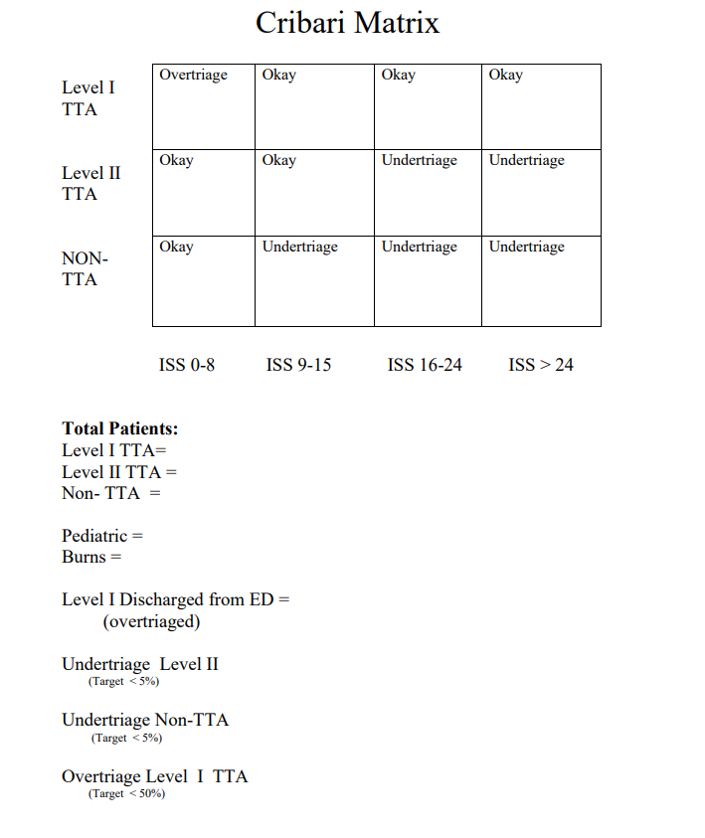
Notes:
The Cribari is one method to calculate over and under triage. This can be used concurrently or retrospectively. However, for each admission you will want to examine if they met any of your trauma activation triage criteria and if it matched up.
Reference: https://regionstraumapro.com/post/186001610095/the-cribari-grid-and-over-undertriage

Slide 20
Report Writer

Slide 21
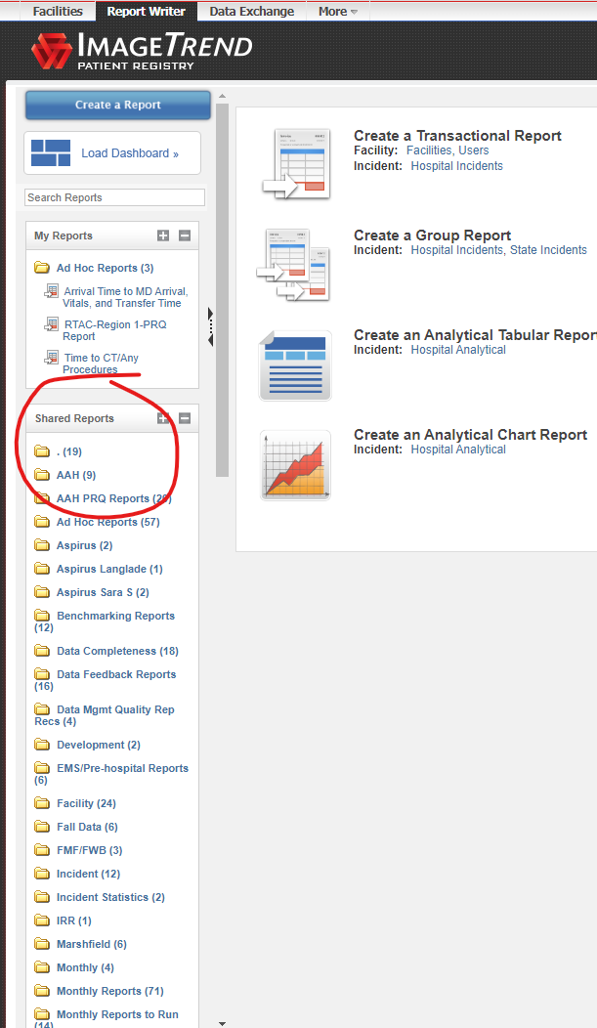
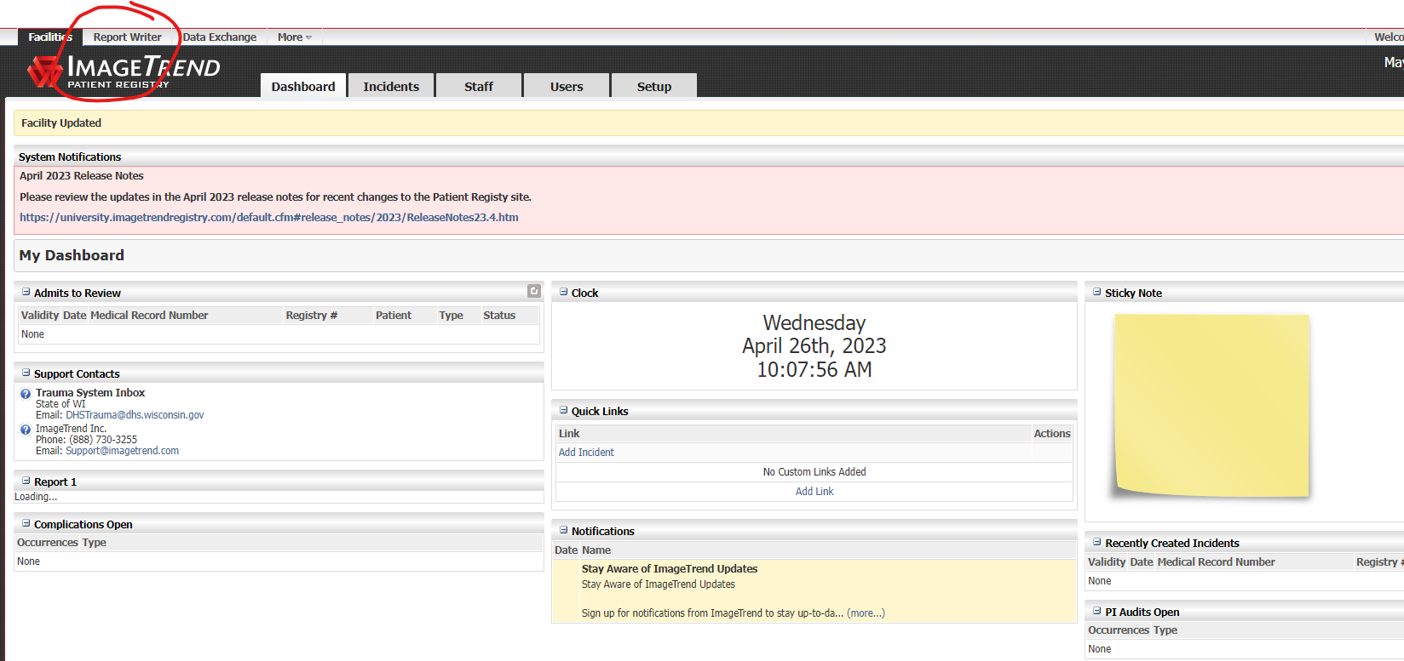
Report Writer
Notes:
Within the trauma registry you have access to numerous premade reports in addition to the ability to make your own.

Slide 22
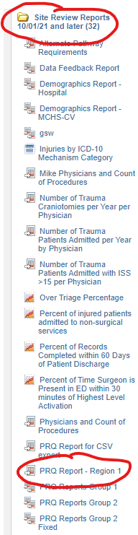
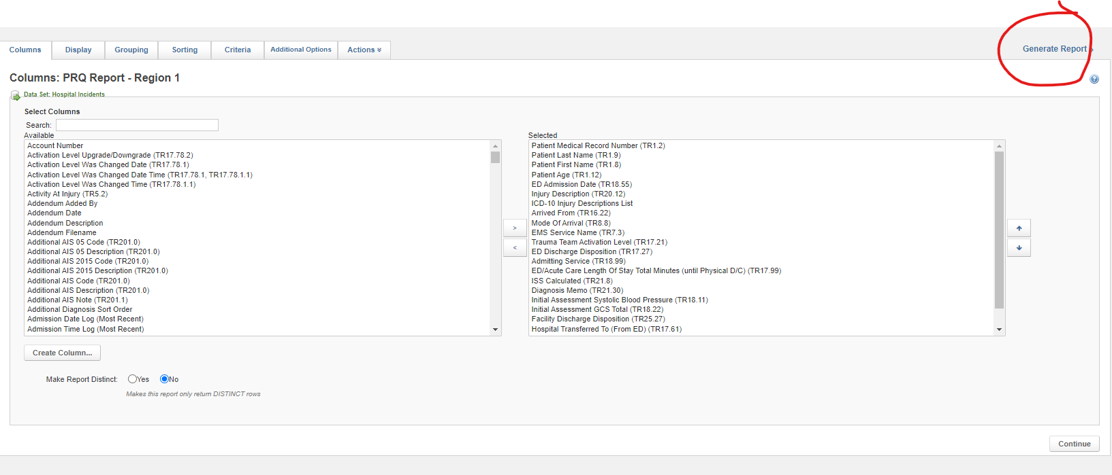
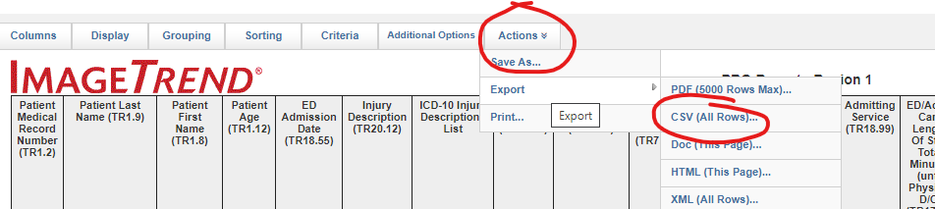
PRQ Report-Region 1
Notes:
Under “Site Review Reports 10/01/21 and later there is a report called PRQ Report-Region 1. This report is a large data table with numerous different elements listed to help you fill out your PRQ or other PI uses.

Slide 23
What is RTAC?
Regional Trauma Advisory Council-Region 1
Notes:
RTAC stands for Regional Trauma Advisory Council (RTAC). RTAC is a group of healthcare organizations and EMS to get together every other month to discuss regional trauma issue.

Slide 24
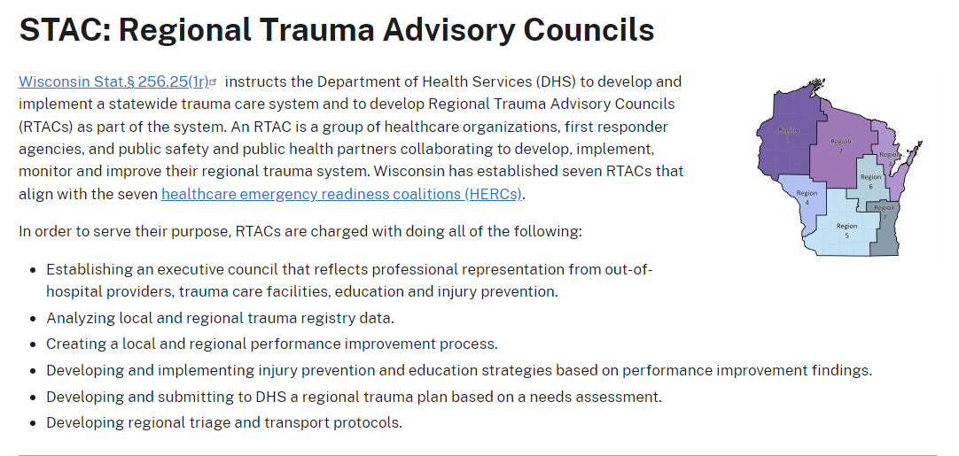
Notes:
RTAC’s purpose is:
Establishing an executive council that reflects professional representation from out-of-hospital providers, trauma care facilities, education and injury prevention.
Analyzing local and regional trauma registry data.
Creating a local and regional performance improvement process.
Developing and implementing injury prevention and education strategies based on performance improvement findings.
Developing and submitting to DHS a regional trauma plan based on a needs assessment.
Developing regional triage and transport protocols.
Robert Goodland is currently our RTAC coordinator. Wayne Street from Mayo-Eau Claire and Susan Ehman from Regions hospital are our Co-Chairs.

Slide 25
What is stac?
Notes:
STAC stands for Statewide Trauma Advisory Council.

Slide 26
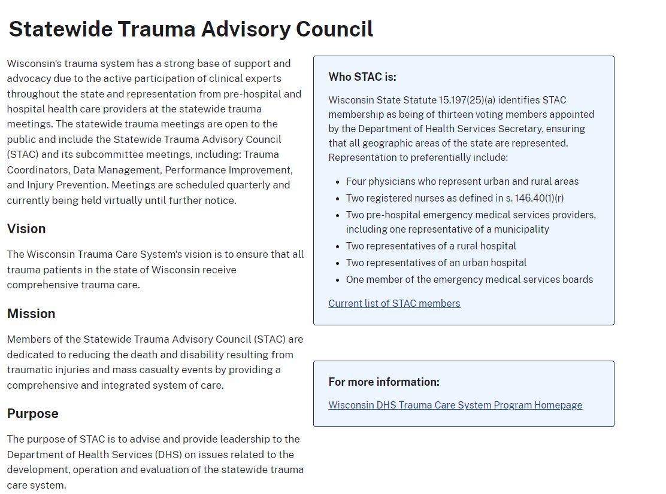
Notes:
Wisconsin's trauma system has a strong base of support and advocacy due to the active participation of clinical experts throughout the state and representation from pre-hospital and hospital health care providers at the statewide trauma meetings. The statewide trauma meetings are open to the public and include the Statewide Trauma Advisory Council (STAC) and its subcommittee meetings, including: Trauma Coordinators, Data Management, Performance Improvement, and Injury Prevention. Meetings are scheduled quarterly in Madison with a virtual option.

Slide 27
resources
NWWI RTAC Coordinator: Rob Goodland- rtac@nwwiherc.org
Region 1 HERC Coordinator: Aimee Wollman Nesseth- coordinator@nwwiherc.org
State Trauma Coordinator: Margaret Finco- margaret.finco@dhs.wisconsin.gov
Trauma Registry Data Manager: Katie Prather- Katie.prather@dhs.wisconsin.gov
Trauma Program Manager Mayo Eau Claire/CRC Chair: Wayne Street- street.Wayne@mayo.edu
Trauma Registry/PI Mayo Eau Claire: Jenny Mazur- mazur.Jennifer@mayo.edu

